Slide 1

Next in Tech: Navigating the
Semiconductor Industry
Kicking A$$ets
Rhea Kumar | Hannah Liu
Temple University, Fox School of Business
Philadelphia, March 6, 2021
1

Slide 2

Table of Contents
Executive Summary
4
I. Industry Overview
6
II. Company Analysis
A. Nvidia
13
B. Advanced Micro Devices
C. Strategic Fit
III. Financial Analysis
A. Comparables
31
B. Discounted Cash Flow
C. Synergies
IV. Acquisition Feasibility
V. Alternative Solution
VI. Conclusion
51
59
71
Appendix
73
91
Bibliography
Executive
Summary
Industry
Overview
Company
Analysis
Financial
Analysis
Acquisition
Feasibility
Alternative
Solution
Conclusion
2

Slide 3
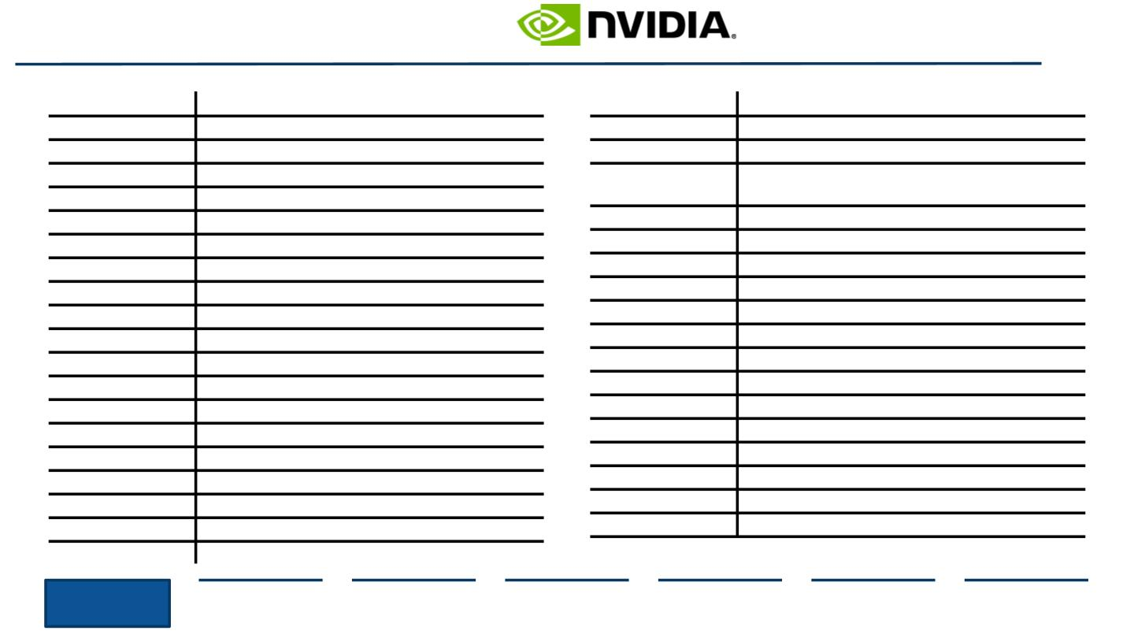
Table of Abbreviations
Abbreviation
Explanation
Abbreviation
Explanation
SCM
Supply Chain Management
P/E
Price to Earnings (ratio)
IPU
Integrated Processing Unit
Graphics Processing Unit
Original Equipment Manufacturer
Integrated Circuit
EV/EBITDA
Enterprise Value to EBITDA (ratio)
GPU
OEM
IC
Earnings before Interest, Taxes, Depreciation,
and Amortization
EBITDA
M&A
FY
Mergers and Acquisitions
Fiscal Year
SemiCon
COGS
YoY
Semiconductor
Cost of Goods Sold
Year-over-Year
ASIC
AI
Application-Specific Integrated Circuit
Artificial Intelligence
Semi-C
dGPU
mm
Enterprise, Embedded, and Semi-Custom
Discrete GPU
AWS
CAGR
R&D
GHG
HPC
TSMC
SDK
TSP
S&P
~
Amazon Web Services
Compound Annual Growth Rate
Research and Development
Greenhouse Gas
Million
B
Billion
AR
Augmented Reality
Virtual Reality
High-Performance Computing
Taiwan Semiconductor Manufacturing Company
Software Development Kit
Tensor Streaming Processor
Standard and Poor’s
VR
SoC
System on a Chip
Central Processing Unit
Communications
CPU
Comm(s)
NTM
LTM
Next Twelve Months
Last Twelve Months
Approximately
Executive
Summary
Industry
Overview
Company
Analysis
Financial
Analysis
Acquisition
Feasibility
Alternative
Solution
Conclusion
3

Slide 4
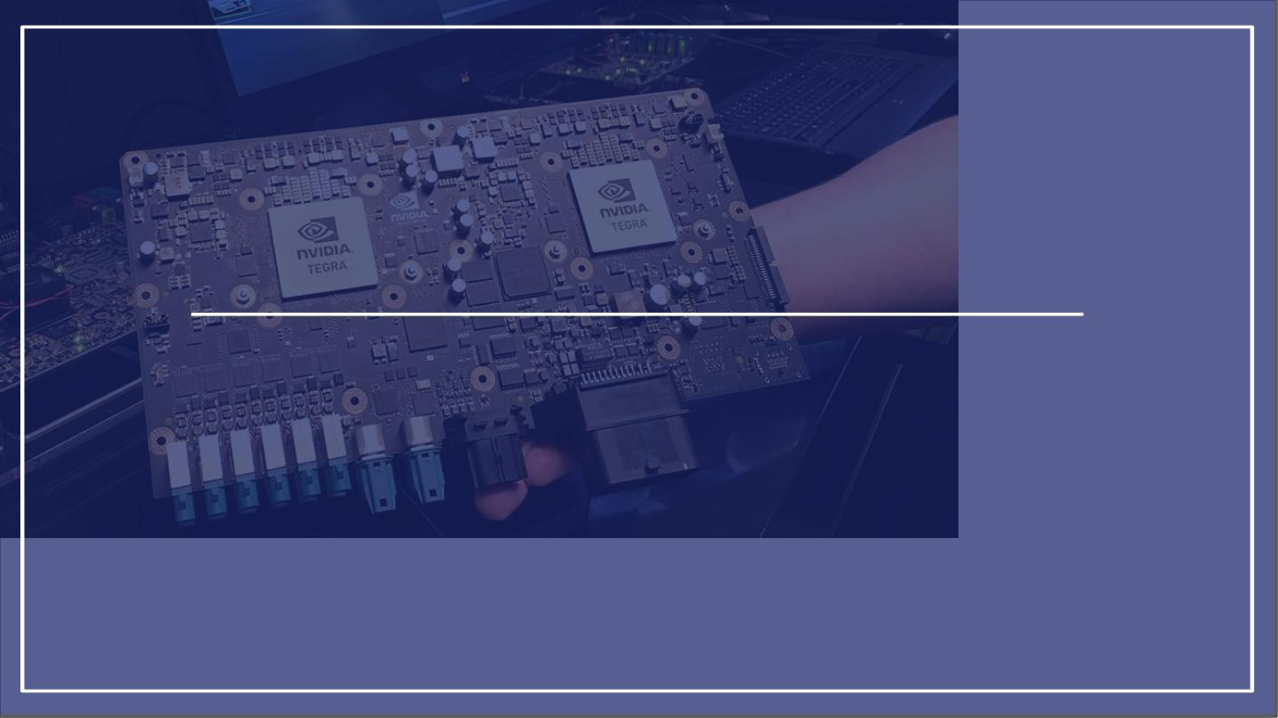
Executive Summary
Nvidia’s Course of Action
4

Slide 5
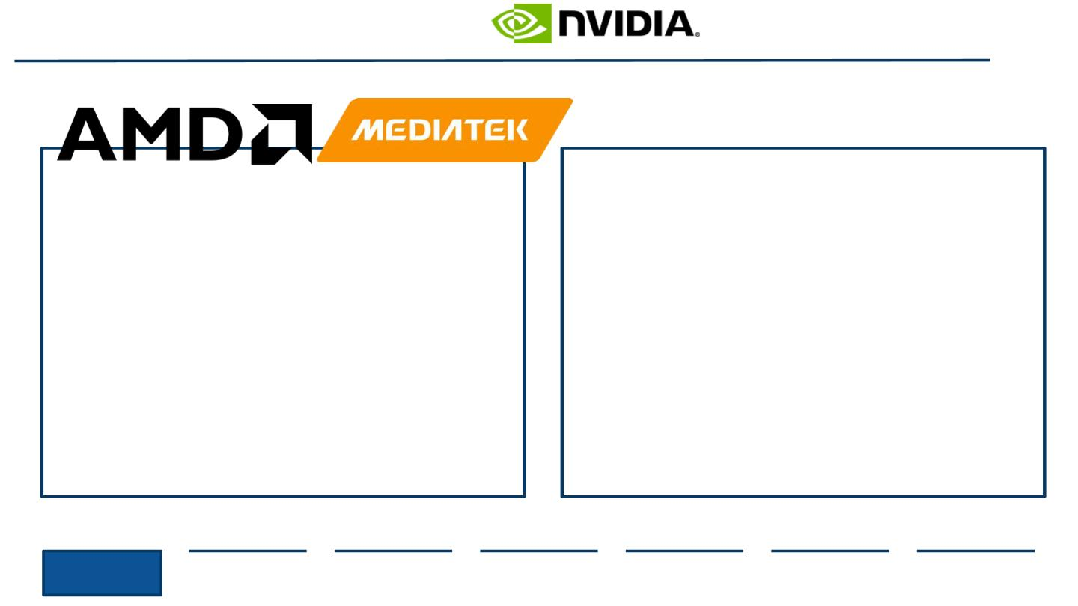
Executive Summary
Should Nvidia acquire Advanced Micro Devices (AMD)?
Nvidia should NOT acquire AMD
Nvidia should acquire MediaTek
●
●
The Market fairly values Mediatek
MediaTek’s corporate strategy, brand portfolio,
and operational business segments closely
align with Nvidia
New and upcoming technology like the
NeuroPilot feature furthers AI development
After analysis of synergies and debt ﬁnancing,
this transaction is feasible
●
●
The market overvalued AMD by 33.4%
The lofty industry premium rate does not
justify the little synergies that result post
acquisition
The debt resulting from the acquisition will
only lead to a destruction of wealth because
of a hefty premium from AMD not wanting to
sell
●
●
●
Executive
Summary
Industry
Overview
Company
Analysis
Financial
Analysis
Acquisition
Feasibility
Alternative
Solution
Conclusion
5

Slide 6
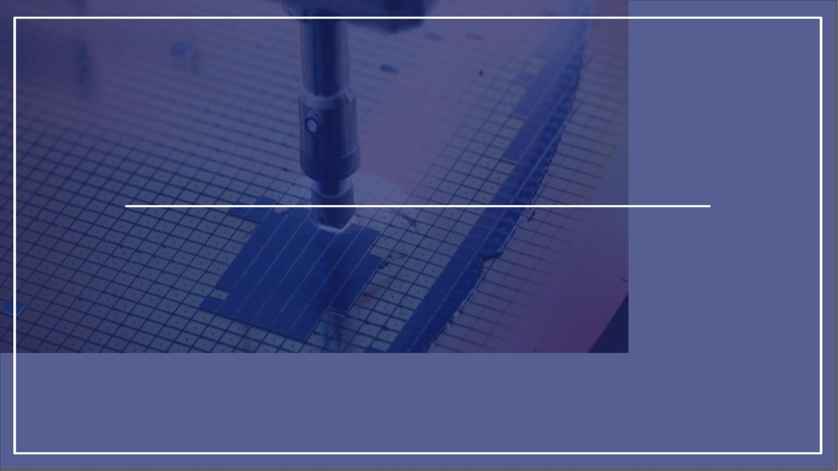
I. Industry Overview
Deﬁning and Shaping the
Industry
6

Slide 7
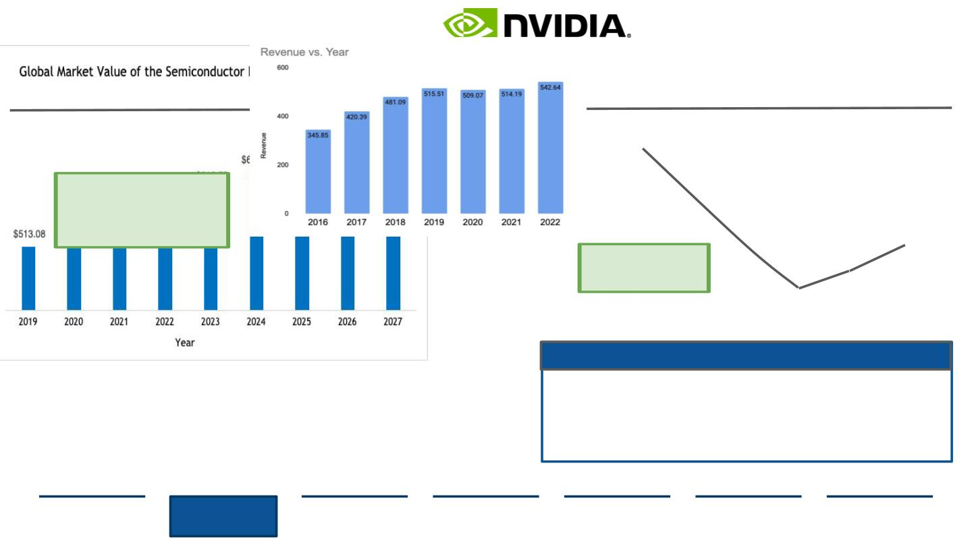
The Semiconductor Industry Overview
A CAGR of 4.7% indicates Semiconductors are expected to grow to a market value of
$700B+ by 2027, but the growth rate year-over-year is seeing slow-downs
As technology advances, the need for SemiCons increases, causing growth
...but the present growth rate for Semiconductor sales decreases
Global Market Value of the Semiconductor Industry, 2019-2027, USD Billion
FY2020
Global Semiconductor Sales Revenue, 2016-2022, USD Billions
During COVID-19, a semiconductor
shortage began. Estimates forecast
non-Covid impacted metrics to
show the growth/slow down even
without the disruption
18%
13%
7%
5%
2019 showed one of the
biggest declines in
decades
1%
-1%
Industry Trends
Moore’s Law- speed and capabilities of computers doubles every two years which means
the transistors in a microchip increase. Companies like Intel that enjoy a premium
valuation may get crushed when they can no longer continue to deliver. 2019 showed this
when Moore’s Law ﬁnally slowed
System on a chip (SoC)- an IC that integrates all or most components of a computer.
Signiﬁcantly reduces waste, energy, and space of larger systems as they are integrated in
portable systems like tablets and smartphones.
Source: (Deloitte, 2019), (Rotman, 2020), (World Semiconductor Trade Statistics, 2020)
Executive
Summary
Industry
Overview
Company
Analysis
Financial
Analysis
Acquisition
Feasibility
Alternative
Solution
Conclusion
7

Slide 8
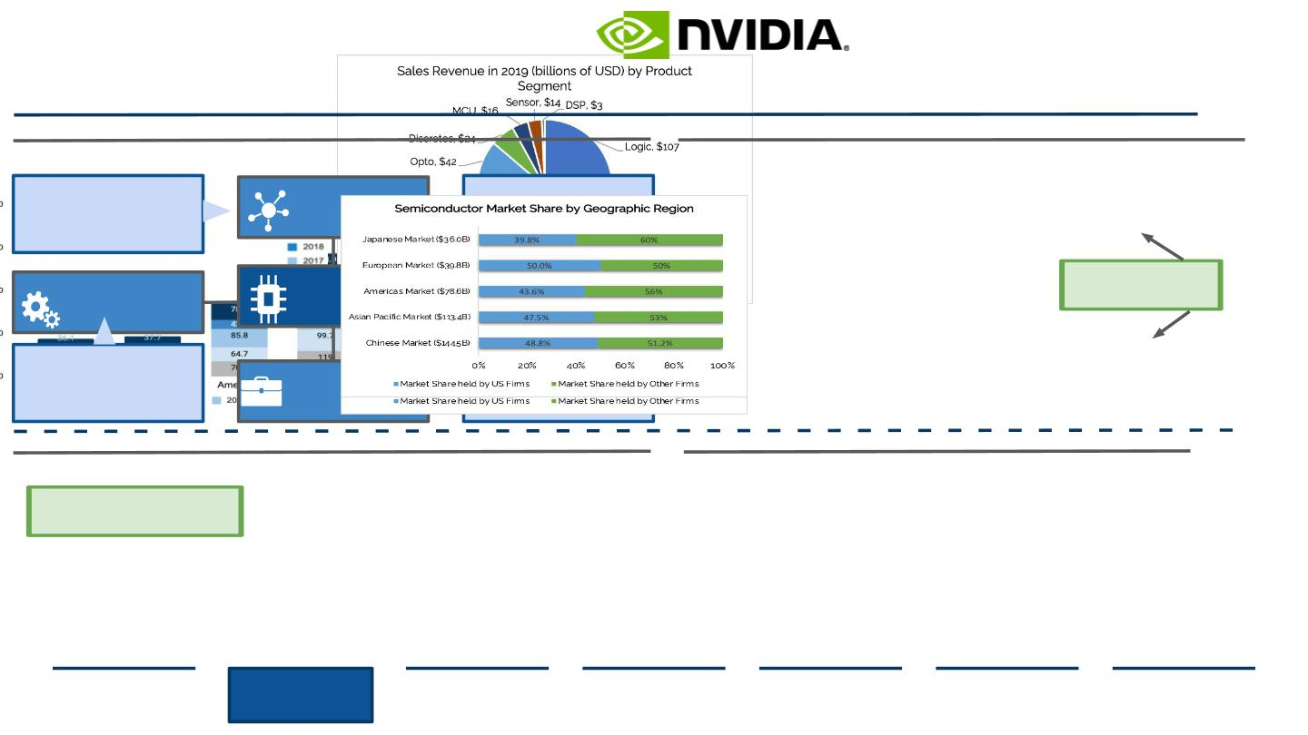
Specializations within the Industry and Regional Insights
Semiconductor vertically-integrated companies comprise the greatest market share and
have the advantage as R&D costs correlate with increases in revenue margins.
Large SemiCon companies outsource manufacturing to focus on R&D dev ...and innovation in the Memory and Logic space continues to rise
Semiconductor Industry Segmentation
2019 SemiCon Product Segment Sales Revenue, USD Billions
Design Companies are a primary
Manufacturers have fabless
models. Manufacturing is
outsourced and designs are
later implemented.
acquisition target for larger
companies to expand R&D and
capitalize on new trends
Design Companies
GPUs and advanced CPUs
are made out of
logic/memory SemiCons
Analog Manufacturing
SemiCon Industry
Digital Manufacturers
Analog semiconductors
condition and regulate “real
world” functions such as
temperature, speed, sound and
electrical current.
Goal to achieve vertical
integration by gaining control of
supply chains and relying less
on third parties to stay
competitive
Vertically Integrated
Companies
China and Asia Paciﬁc currently hold the greatest revenue of SemiCons
...but US Companies have heavily settled in Asian Markets
Semiconductor Regional Sales, USD Billion
Semiconductor Market Share by Geographic Region, FY2020
China is aiming to become
semiconductor self suﬃcient which
threatens global SemiCon shortages
Source: (Semiconductor Industry Association, 2019), (Fortune Business Insights, 2018)
Executive
Summary
Industry
Overview
Company
Analysis
Financial
Analysis
Acquisition
Feasibility
Alternative
Solution
Conclusion
8

Slide 9
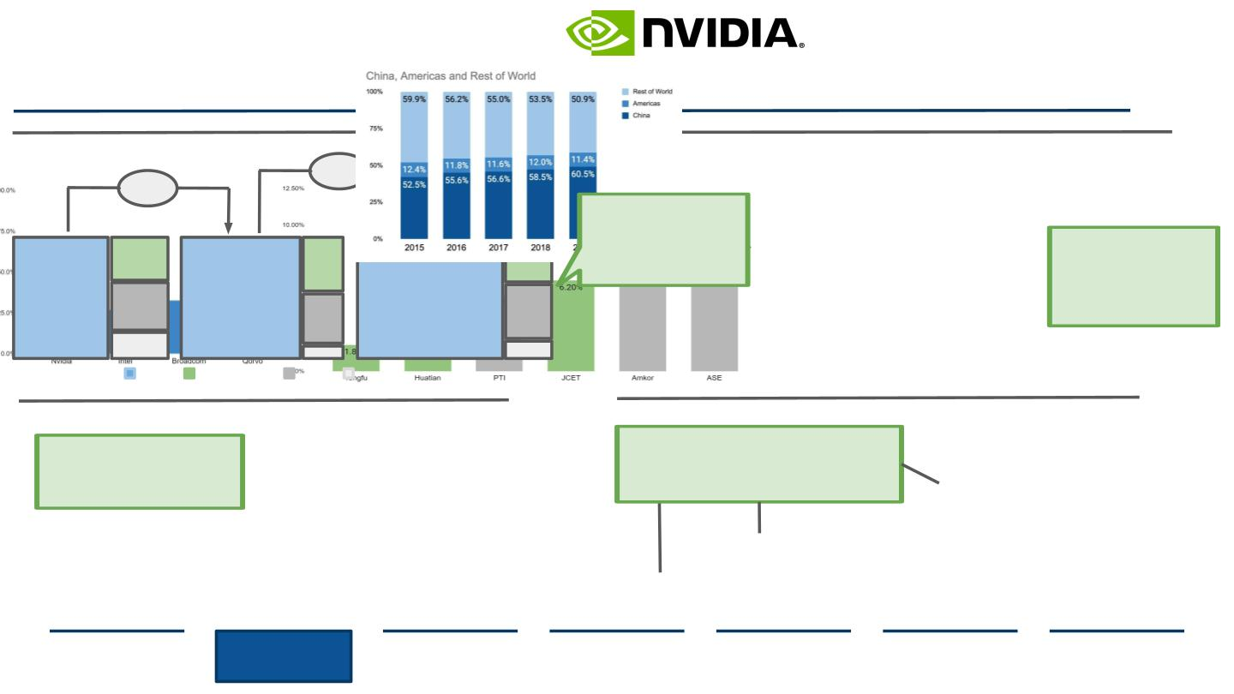
China’s Semiconductor Threat
As China expands SemiCon manufacturing capabilities, the country chases ‘technology
independence’, holding consequences for US market share and revenue
The phases of China’s Semiconductor growth are picking up
...and China consumes more than 50% of all SemiCons manufactured
Domestic M&A Volume Growth- East Asia, 2014-2018
Semiconductor Market Share by Region, 2015-219
18%
30%
China has been
2018
responsible for derailing
many international
company’s domestic
acquisitions like NXP and
ARM
11
Currently, domestic
manufacturers are only
capable of meeting 30% of in
house demand. China’s
government is pushing
campions to increase
capabilities
2016
51
11
2017
10
10
11
6
10
2
73
89
2
China
South Korea
Japan
Taiwan
Around 10% of Semiconductor manufacturing operates in China
...therefore companies depend on China for large revenue %
Semiconductor MNC Revenue From China, FY2020
Top SemiCon Packaging and Testing Companies
All these MNCs are US based
companies importing and operating in
China. Large revenue percentages
indicate a dependence on exports to
the country.
From 2010 to 2016, the output value of China's local
packaging and testing industry increased from RMB
62.9 billion to RMB 156.4 billion at a compound annual
growth rate of 20%, higher than the global average.
2.8B
14.0B
2.01B
2.7B
20.26B
7.81B
Source: (Deloitte, 2019), (PricewaterhouseCoopers , 2016)
Executive
Summary
Industry
Overview
Company
Analysis
Financial
Analysis
Acquisition
Feasibility
Alternative
Solution
Conclusion
9

Slide 10
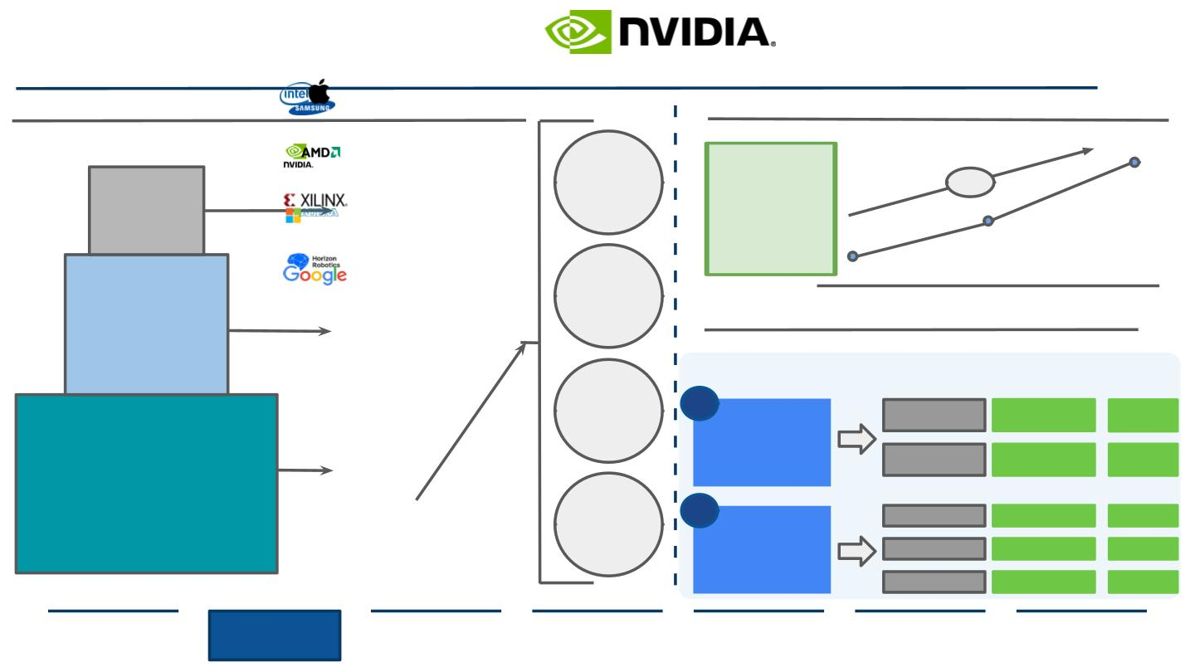
AI is Changing the Semiconductor Industry
Companies are Moving to Become More Specialized to Innovate
Segments of the AI Industry- where SemiCon Companies operate
The AI Industry is only expected to exponentially grow YoY
Technology companies are hopping on the AI Chip trend
Global Estimated Size of SemiCon Market, USD Billions
CPU
AI will allow
● Voice Assistants
● Autonomous Driving
● Automated Customer
Service
● Robotics
semiconductor
74%
65
companies to capture
40 to 50 percent of
total value from the
technology stack,
representing the best
opportunity they’ve
had in decades.
Application
32
GPU
17
● Imageing
2017
2020
2025E
Technology
● AI Development
● Machine Learning
● Speech/Body Language
Reception
Cloud-based AI chips are the most promising segment
AI Chip market further segmented into cloud and edge
● Deep Learning
FPGA
Deployment
Application Market Potential CAGR
(2022)
1
2
Training
17 B
~55%
● Data Analysis
● Computing
● Sensors
Cloud Based
Infer
7 B
~85%
Infrastructure
ASIC
● AI Chips
Security
AV
2 B
5 B
4 B
~40%
~43%
~60%
Networking
Edge
Source: (Alam, 2020), (McKinsey & Company, 2019), (Deloitte, 2019)
Phones
Executive
Summary
Industry
Overview
Company
Analysis
Financial
Analysis
Acquisition
Feasibility
Alternative
Solution
Conclusion
10

Slide 11
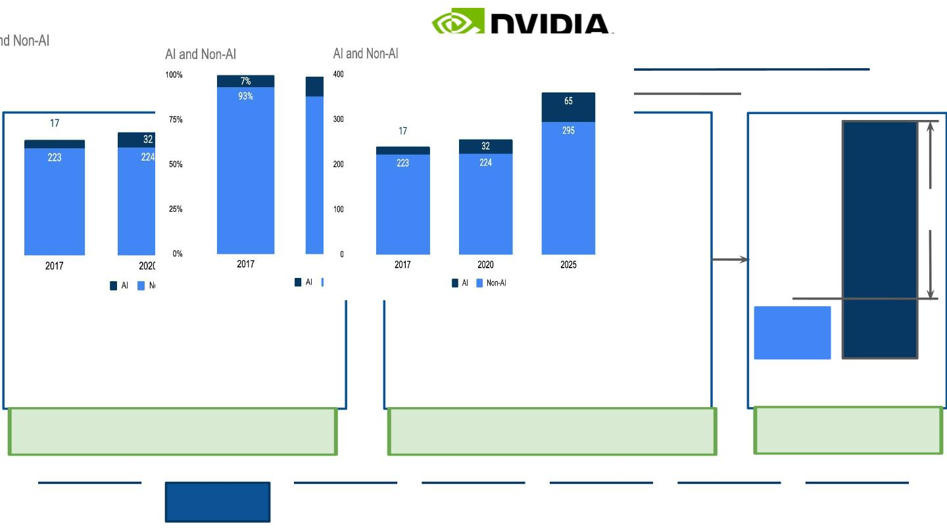
AI Acceleration
The Future of AI Will Disrupt Current Chip Trends
AI Semiconductor related growth is expected to be 5x more than the rest of the market
Estimated AI Semiconductor
Market CAGR
AI Semiconductor Total Available Market, USD Billions
AI Semiconductor Total Available Market Percent
18-19%
5x
3-4%
Non-AI
AI
Hardware serving as the diﬀerentiator in AI, greater demand for chips and also
greater prospects for proﬁts from developing novel technologies such as workload
speciﬁc AI accelerators. AI-related semiconductors will see growth of more than 18
percent annually over the next few years
Next-gen accelerator architectures which increase computational eﬃciency or
facilitate the transfer of large data sets through memory and storage oﬀer
performance improvement so great that customers would be willing to pay.
Increased expenditure of AI in every business
segment has presented the opportunity for
enhanced growth, demonstrating ﬁeld
disruption and change.
Source: (Accenture, 2019), (McKinsey & Company, 2019)
Executive
Summary
Industry
Overview
Company
Analysis
Financial
Analysis
Acquisition
Feasibility
Alternative
Solution
Conclusion
11

Slide 12
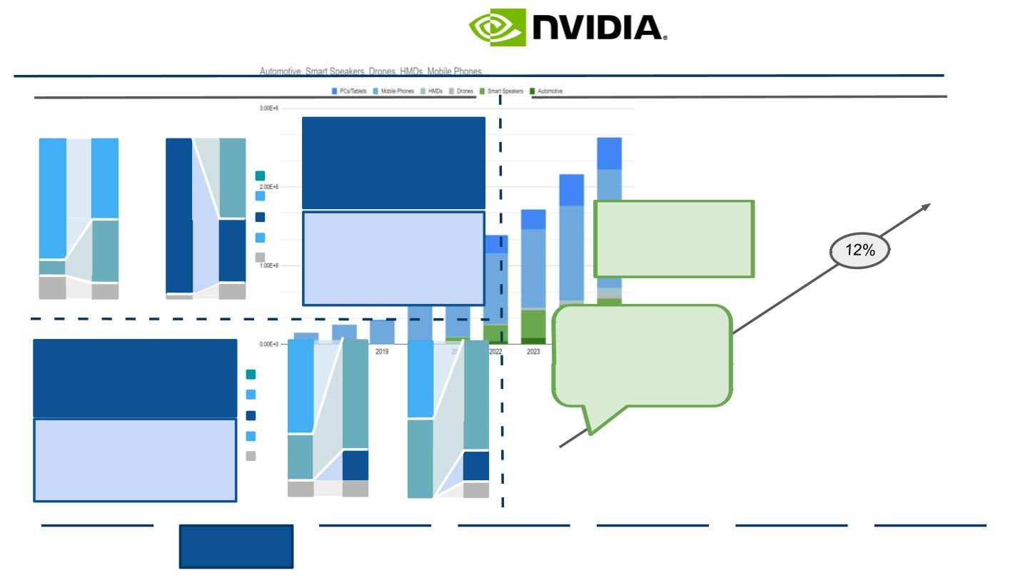
AI Industry Implications
How a Shift in Trends Creates an Innovative Environment for Companies
Infrastructure components for data centers and edge are shifting
Companies are ﬁnding new industries to implement AI Chips
Predicted Change in Data Center Architecture Percent, 2017-2025
AI Edge Device Shipments by Segment, USD Millions, 2017-2025
Inference
Training
Inference
75
50
97
50
GPUs are used for almost all training. They will
soon lose market share to ASICs, until the
compute market is evenly divided by 2025. As
ASICs enter markets, GPUs will likely become
more customized to meet the demands of DL.
ASIC
CPU
FPGA
GPU
Other
By 2025, the market is
expected to consist of
19% AI chips showcased
by the advancement in
each industry sector.
40
40
Training
ASICs and GPUs, FPGAs will have a small role in
future AI training, mostly for specialized
data-center applications that must reach the
market quickly or require customization, such as
those for prototyping new DL applications.
10
15
10
10
2017
2025
Edge Architecture Percent Change
Inference
Training
In 2017 AI chips accounted
for just 7% of the market,
but more than 10% of all
businesses have a hand in
AI development or usage.
Inference
60
70
50
70
GPU usage is declining forcing industry players AMD,
Nvidia, and Intel to manufacture other components.
ASIC chips are increasing in all markets and are seen to
replace most components
ASIC
CPU
FPGA
GPU
Training
30
10
50
In the future, ASICs built into systems on chips will
account for 70 percent of demand. FPGAs will
represent about 20 percent of demand and will be
used for applications that require signiﬁcant
customization.
Other
20
10
20
10
Source: (Deloitte, 2020), (McKinsey & Com²p⁰a¹n⁷y, 2019)
2025
Executive
Summary
Industry
Overview
Company
Analysis
Financial
Analysis
Acquisition
Feasibility
Alternative
Solution
Conclusion
12

Slide 13

II. Company Analysis
1
2
3
NVIDIA
AMD
STRATEGIC FIT
13

Slide 14

II. Company Analysis
1
2
3
NVIDIA
AMD
STRATEGIC FIT
14

Slide 15
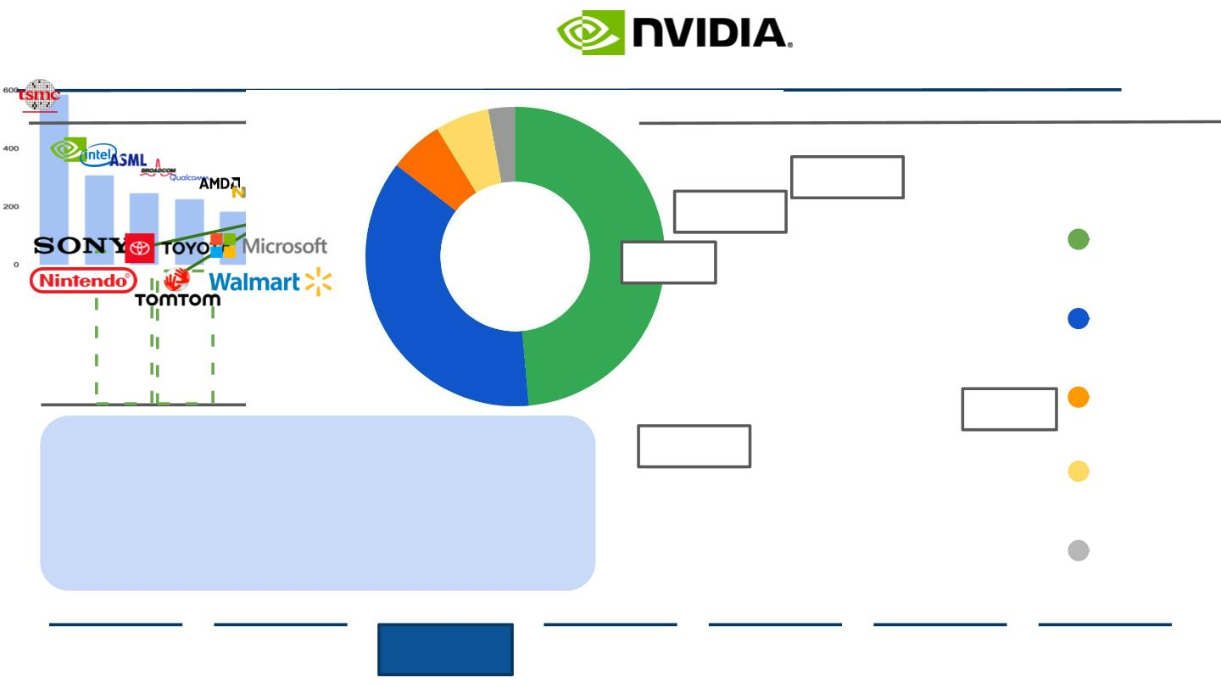
Nvidia Overview
Nvidia has a Signiﬁcant Hold on the GPU and Gaming Industry
Nvidia is growing at a larger rate compared to rival industry competitors
In 2021 Gaming consists of 55% of Nvidia’s Revenue Stream
Market Cap of Semiconductor Manufacturers, USD Billion, FY2020
Nvidia Revenue Breakdown, 2021
OEM/Other
Nvidia holds the largest market
cap when the industry is
segmented into GPUs and
Gaming
3%
Automotive
6%
Gaming
Pro Vis
6%
586.9
Data Center
309.0
246.7
225.7
183.8
147.4
95.1
50.1
50.0
Gaming
55%
Pro Vis
Nvidia Industry Partners
Data Center
38%
Automotive
OEM/Other
Source: (CNN, 2021), (Companies Market Cap, 2021), (Nvidia, 2021)
Executive
Summary
Industry
Overview
Company
Analysis
Financial
Analysis
Acquisition
Feasibility
Alternative
Solution
Conclusion
15

Slide 16
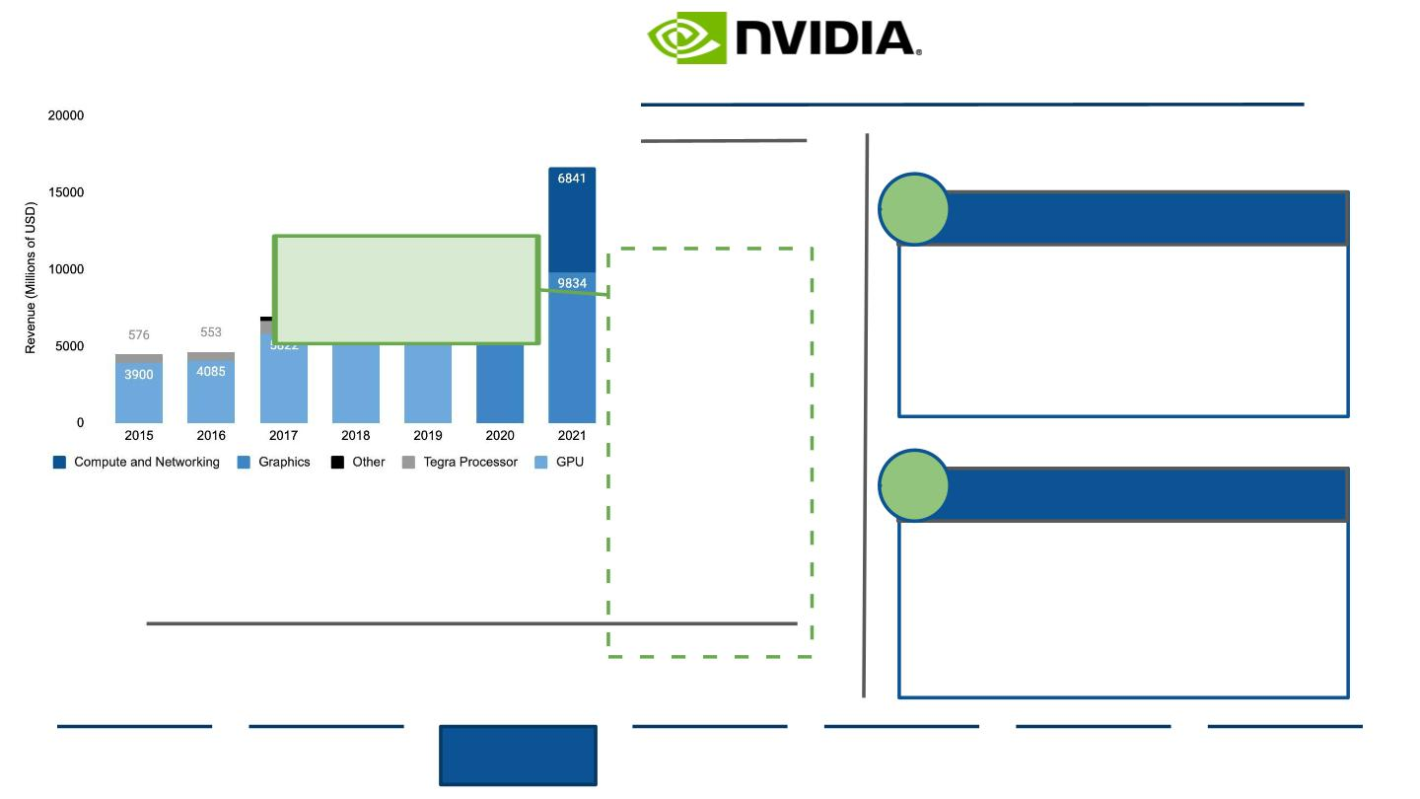
Nvidia’s Current Business Targets
Nvidia Switches Operations Category on i t’s Primary Revenue Streams
Before 2020: Graphic Processing Units+Tegra Processors=Nvidia’s Gaming Presence
Nvidia’s entry into the AI chip space
opened up new markets
Post 2020: Graphics+Compute & Networking=Nvidia’s Overall Presence
Nvidia Revenue By Segment
1
Compute and Networking
In 2020, Nvidia Revenue
segmentation changed to
account for increases in AI
chip innovation
Data Center Platforms- accelerated computing platform,
integrated across hardware and software
AI Systems- across various industries to increase data drivenness
Autonomous Vehicles- NVIDIA DRIVE: an open AV development
platform for collaboration and innovation
Robotics- Development with AI technology, impact through
deployment into GPU-accelerated applications
2
Graphics
Specialized Gaming Markets- a primary revenue driver and most
interaction with consumer base for gaming
GeForce Series- the top brand of GPUs and the main product in
the discrete GPU market
Cloud Based Visuals- GPU accelerated solutions available
through all top cloud platforms (AWS, GCloud)
Virtual Computing- enables data centers to accelerate server
virtualization with the latest NVIDIA data center GPUs
Source: (Nvidia, n.d.), (Pirzada, 2019), (Statista, 2021)
Executive
Summary
Industry
Overview
Company
Analysis
Financial
Analysis
Acquisition
Feasibility
Alternative
Solution
Conclusion
16

Slide 17
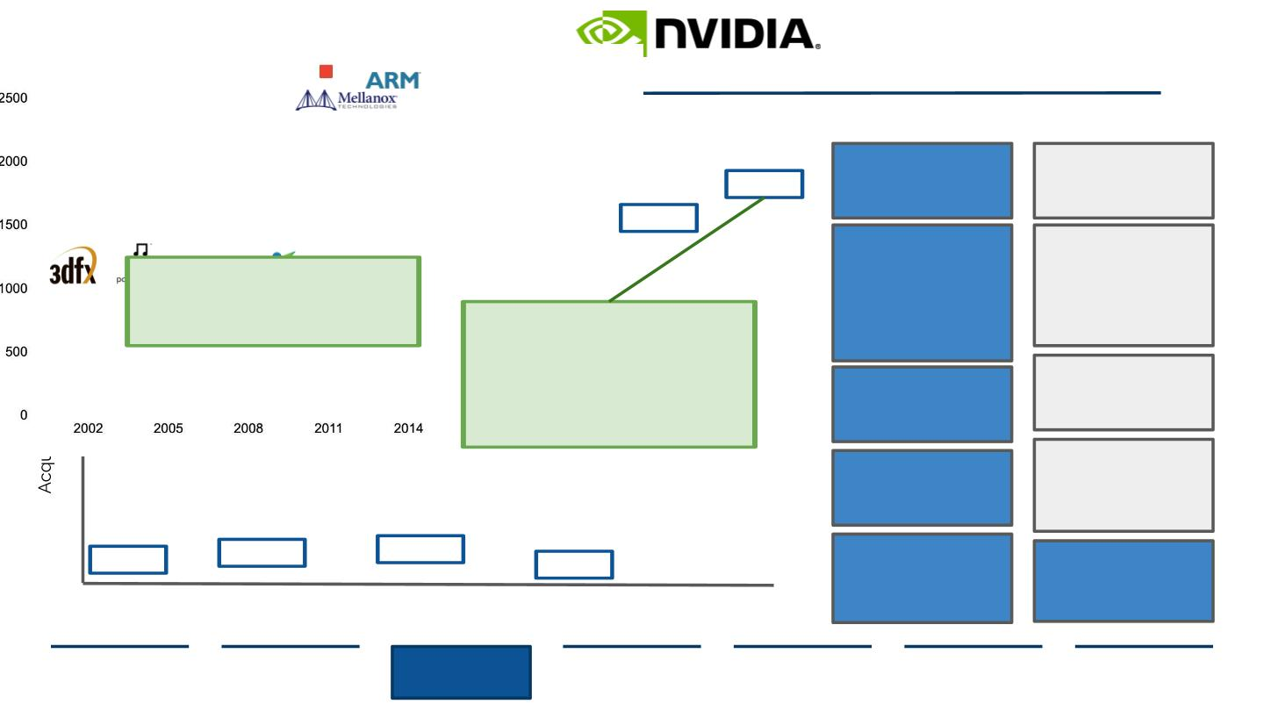
Nvidia’s Past Acquisitions
Nvidia has a History of Buying Competition and New Technology
Nvidia’s Prime Acquisitions Lead to Control over the GPU Space
Nvidia’s Two Types of Acquisitions
Nvidia’s Major Acquisitions and Mergers 2002-2020
Innovation Expansion
and Staying Ahead
of Trends
Operational
Eﬃciency and
Increasing
7
40 B
7 B
Competitiveness
6
Innovation leads to the
growth of new markets
for company expansion.
Sector growth leads to
increased
Strategic
implementation of
acquisition resources
places increased
eﬃciency in supply
chain.
The key to Nvidia’s acquisitions is
5
4
vertically enhancing their value
chain going from a chip company to
a data center-scale company
In 2020, Nvidia announced its
acquisition of ARM Holdings, making
headway into the AI space. The
proposed deal is met with much
scrutiny from regulators pending
investigation.
opportunities.
PortalPlayer: lead to
expansion in the
portable gaming
market
3dfx:
lead to IP rights
obtainment and
increasing SCM
capabilities
3
2
1
Mellanox:
technology
protection from Intel
and accelerating
systems
Icera: lead to new
OEM customer markets
in mobile computing
357 mm
375 mm
Transgaming: lead to
cloud integration in
telecom space and
corp expansion into
Canada
ARM Holdings:
pending deal. Leads to
dominance in AI
capabilities
70 mm
3.8 mm
2002
2004
Source: (Crunchbase, 2021), (Reif, 2020)
Executive
Summary
Industry
Overview
Company
Analysis
Financial
Analysis
Acquisition
Feasibility
Alternative
Solution
Conclusion
17

Slide 18
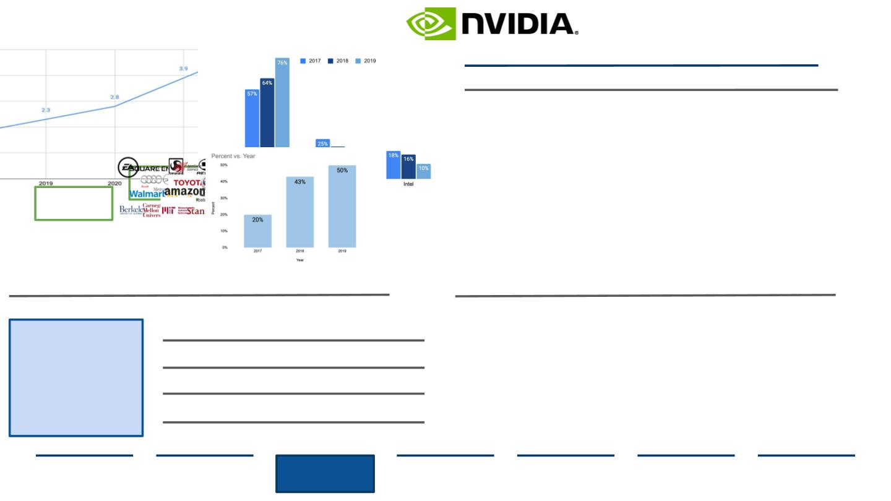
Nvidia’s Capabilities and Strengths
Nvidia is Positioned to Remain an Industry leader with Innovation Expansion
Nvidia remains a ﬁgurehead in product development and design
...which lead to brand recognition preference among consumers
Nvidia’s Past and Forecasted R&D Expenses, USD Billion
PC Graphics Card Market Among Gamers on Stream
●
Customer and brand
loyalty remain at the crux
of Nvidia’s relationships
and sales drivers
Customer integration in
all aspects of the supply
chain. Ex: customer
quality engineering and
customer program
●
●
●
Research and Development
growth rate more than
doubled since 2018 (1.8B)
High R&D spending in
Machine Learning and AI chip
innovation
“...Professionals believe NVIDIA
graphics solutions to be more
stable and of better quality than
any other brand available.”
-TBR Research
+28%
●
+18%
Company acquisitions
increase R&D capabilities
management
… as well as enhancing projects with other key industry players
…and still remains sustainably responsible in its Supply Chain
Nvidia’s partnerships simplify technological architecture
Year Over Year Percent Decrease in Pallet Usage
Recent partnerships
have seen the
Gaming:
●
●
●
Commitment to sustainability
from company projects to
subcontractor logistics
Application of material labels
to 100% of packages to
encourage recycling
Conﬁguration of packaging to
reduce pickups/deliveries
acceleration of AI.
Nvidia provides client
services along with
component delivery
as part of vertical
integration.
Automotive (AV):
E-commerce:
Research:
Source: (Nvidia, 2021), (Statista, 2018), (Statista, 2021)
Executive
Summary
Industry
Overview
Company
Analysis
Financial
Analysis
Acquisition
Feasibility
Alternative
Solution
Conclusion
18

Slide 19
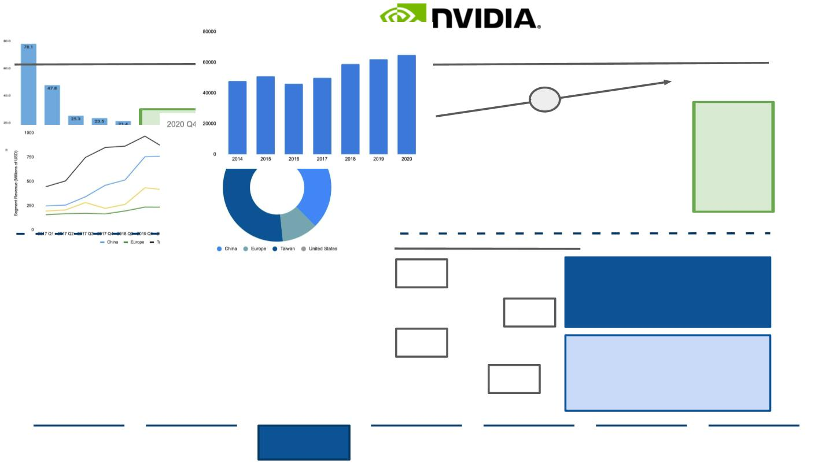
Nvidia’s Primary Challenges and Opportunities
Nvidia is 10th in Comparable Companies, Yet Depends on Several Contingencies
Nvidia is 10th in Revenue compared to other Semicon companies
...but even without market dominance, environmental concerns rise
FY2020 Revenues of Top 10 Semiconductor Manufacturers, USD Bn
Nvidia Greenhouse Gas Emissions, Metric Tons of Carbon Dioxide (CO₂)
35%
Expanding
Nvidia operates in a very
competitive niche segment
where GPU sales are expected
to slow in the future
business/
business
acquisition leads
to liabilities like
GHG emissions.
For Nvidia,
emissions are at
every stage of
the product life
cycle.
GPU sales could keep declining amid US-China relations
Nvidia Geographical Segment Revenues, USD Mn
US
13.3%
For every 1% drop in China revenue
growth, Nvidia total revenue growth
will drop 1.5% because of the
correlated growth across the revenue
segments.
Taiwan
China
China
37.6%
US
Taiwan
38.3%
While Nvidia holds unique positions in
niche markets, its supply chain relies
on Chinese consumers. The country
threatens to be self sustaining in the
Europe
Europe
10.7%
semiconductor
industry,
currently
Source: (Ma, 2019), (McKinsey & Company, 2019), (Nvidia, 2019)
supplying 30% of chips domestically.
Executive
Summary
Industry
Overview
Company
Analysis
Financial
Analysis
Acquisition
Feasibility
Alternative
Solution
Conclusion
19

Slide 20

II. Company Analysis
1
2
3
NVIDIA
AMD
STRATEGIC FIT
20

Slide 21
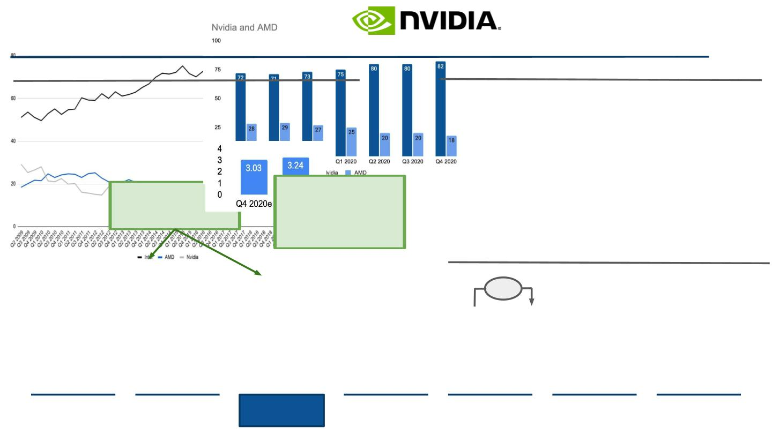
Advanced Micro Devices versus Competitors
AMD is Encroaching on its GPU Competition with Nvidia and Intel
AMD outperforms Nvidia approximately half of the time in PC GPUs
Percentage of PC GPU Shipment Share By Vendor, Q2 2009-Q4 2020
...yet Nvidia outperforms in a two company controlled segment
Percentage of PC dGPU Shipment Share, Q1 2019-Q4 2020
New releases increase likelihood
of one company crossing the
other’s threshold, emphasizing
innovation needs
AMD is forecasted to
permanently overtake Nvidia as
the company releases
technology and features that can
be used on Nvidia graphic cards
giving leeway to gaps in Nvidia
brand loyalty.
...but sales are forecasted to grow in 2021-2022 for Team Red
AMD FY 2020 Q4 Revenue, Actual vs Expected, billions of USD
7%
●
●
AMD continuously outperforms
analysts’ expected earnings
sometimes by 13% at a time
Introduction of new product at
lower prices compared to
competitors drives revenue and
demand
Source: (Jon Peddie Research, 2021)
Executive
Summary
Industry
Overview
Company
Analysis
Financial
Analysis
Acquisition
Feasibility
Alternative
Solution
Conclusion
21

Slide 22
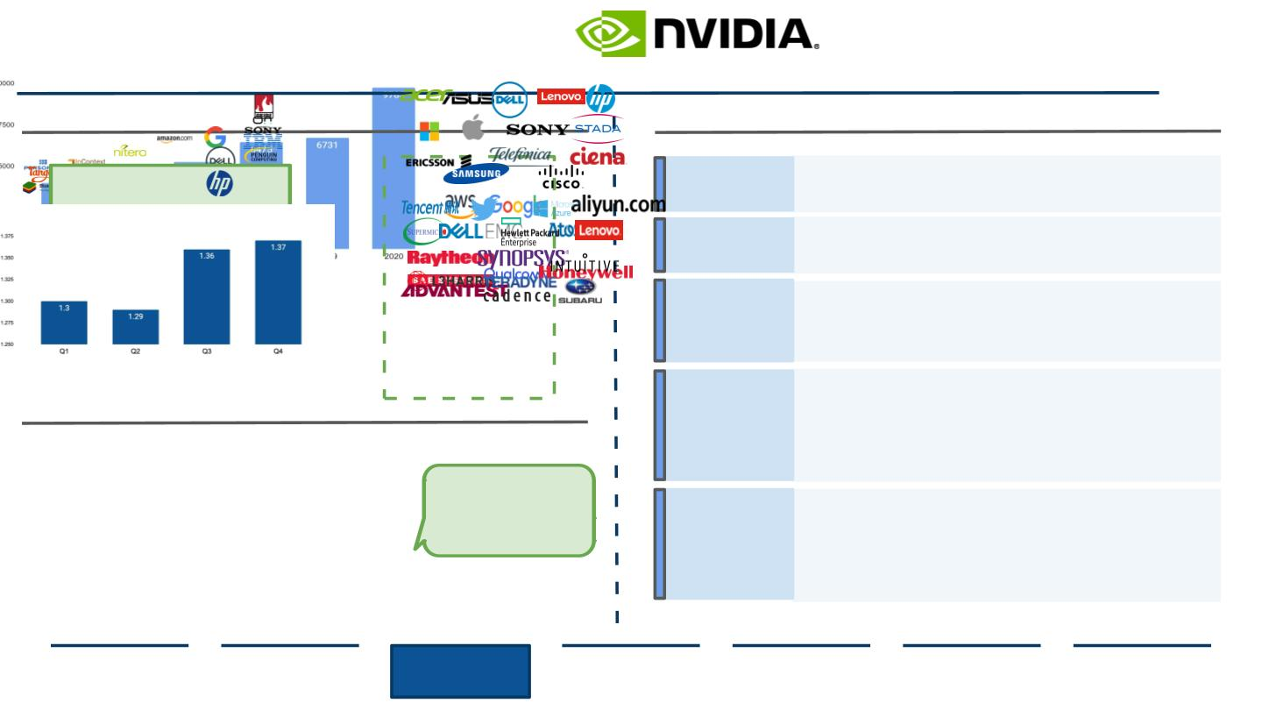
Advanced Micro Devices Project and Market Expansion
AMD is Partnering with Industry Players to Increase Processor Sales
Company partnerships were key in AMD’s 2020 revenue all time high
AMD favorable in collaboration, having deep customer relationships
AMD YoY Revenue, USD Millions and Company Partnerships
AMD Company Customers, 2020
Increases in revenue and company
partnership portfolios are directly
correlated, driving innovation. AMD’s
hopeful $22.5B in revenue will rely on
external collaborations
Compute
Gaming
Comms
AMD’s current asset turnover ratio is 0.82 higher than SemiCon avg
AMD Asset Turnover Ratio by 2020 Quarter
Data Center
Embedded
AMD shows eﬃciency in
revenue and asset
generation allowing for
more investments and
R&D growth.
Source: (Athow, 2020), (Khaveen Investments, 2021), (Tech Power Up, 2020), (Zafar, 2020)
Executive
Summary
Industry
Overview
Company
Analysis
Financial
Analysis
Acquisition
Feasibility
Alternative
Solution
Conclusion
22

Slide 23
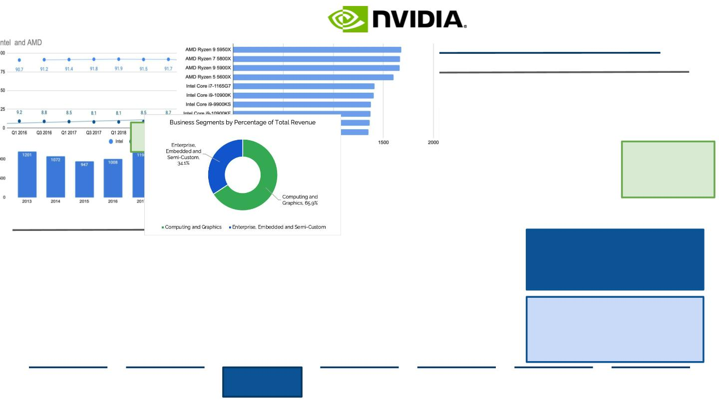
AMD Took Advantage of COVID-19 Markets and Continued to Grow
AMD’s Revenue up by 45% by the End of Q4 in 2020, Promising Growth
In 2020, AMD crept on Intel’s CPU laptop market share by almost 10%
Percentage Distribution of Laptop CPUs Worldwide, Q1 2016-Q3 2020
...and scalability did not aﬀect quality as AMD leads SCP performance
Leading single-core processors (SCP) by Geekbench, January 2021
In 2020 Intel faced a massive CPU
shortage by 8%, allowing AMD to
slide further in the market.
AMD Processors occupy
4/10 spots. AMD's modern
processors tend to oﬀer
either more cores or threads
and faster PCIe 4.0
connectivity at every single
price point
Research and Development expenditures climbed 22% by 2020 Q4
AMD R&D Expenditures, 2013-2020, USD Millions
Business Segment by % Revenue
For every 1% drop in China revenue
growth, Nvidia total revenue growth
will drop 1.5% because of the
correlated growth across the revenue
segments.
While Nvidia holds unique positions in niche
markets, its supply chain relies on Chinese
consumers. The country threatens to be self
sustaining in the semiconductor industry,
currently
supplying
30%
of
chips
Source: (Advanced Micro Devices, 2021), (PassMark, 2020), (Primate Labs, 2021)
domestically.
Executive
Summary
Industry
Overview
Company
Analysis
Financial
Analysis
Acquisition
Feasibility
Alternative
Solution
Conclusion
23

Slide 24
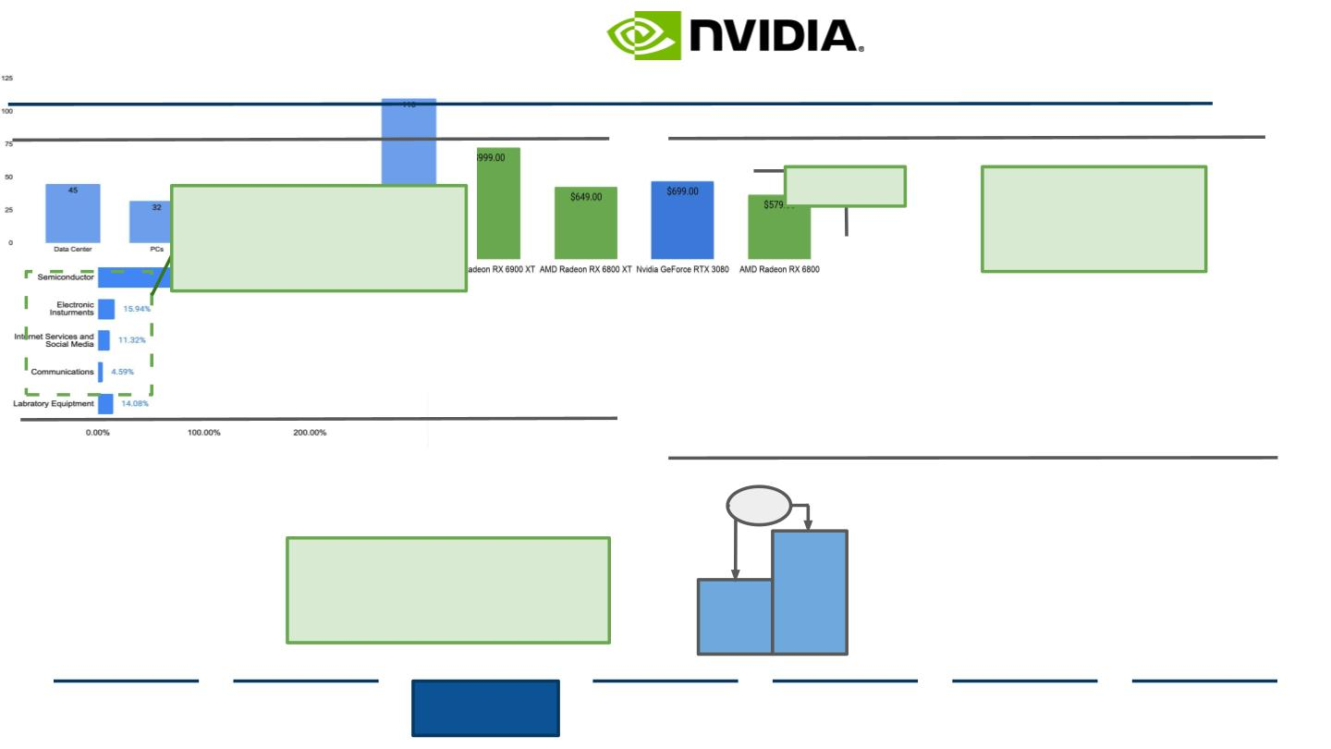
Advanced Micro Devices Capabilities and Strengths
AMD expands industry capabilities through recent acquisition and already emcompasses several
beneﬁts of smaller scale operations, including price point and supplier streamlining capabilities
AMD’s pending Acquisition of Xilinix will increase TAM to $110B USD
Long Term TAMs with Acquisition by Sector, USD Billions
AMD occupies 3/5 spots on the list of best GPUs and beats prices
Prices of Best GPUs, Ranked, 2021
32% more expensive
for similar computing
power
With the new Ryzen 5000 series, AMD
claims as much as a 26% increase in
gaming performance for one of its
new high-end chips compared to its
predecessor, and a 7% gaming
performance advantage over a
comparable GPU
Data Centers are AMD’s primary target for AI
expansion with the integration of Xilinx's
FPGA components. Drive adoption of Xilinx
SmartNIC and other acceleration solutions in
data centers.
…and strong success is shown through AMD’s supplier relationships
AMD’s Suppliers Sales Growth in Q4 2020 by Industry
The company is scaling up SCM capabilities while remaining eﬃcient
AMD FY 2020 Q4 Revenue, Actual vs Expected, USD Bn
31%
●
●
AMD continuously outperforms analysts’
expected earnings sometimes by 13% at a
time
Introduction of new product at lower
prices compared to competitors drives
revenue and demand
Strong collaboration with suppliers leads to stable and
proﬁtable relationships: “I think the channel is just a big
opportunity for us. It’s really a matter of ensuring that as we
scale as a company, we put resources into the channel to
support all of the activities there, and I’m very excited about
the possibilities,”
96%
65%
- Lisa Su, AMD CEO
Source: (Advanced Micro Devices, 2016), (CSI Market, 2020), (Walton, 2021)
Executive
Summary
Industry
Overview
Company
Analysis
Financial
Analysis
Acquisition
Feasibility
Alternative
Solution
Conclusion
24

Slide 25
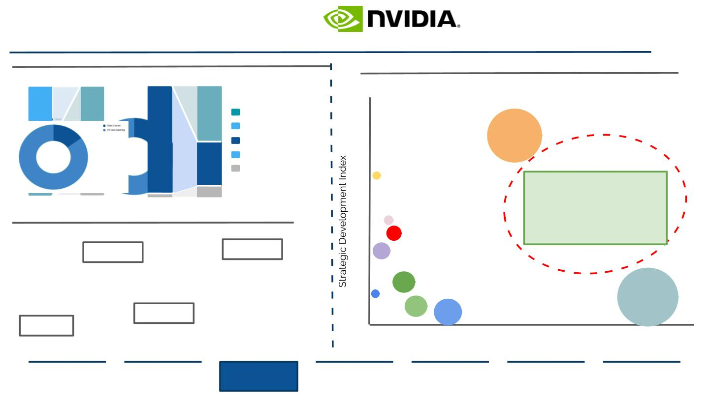
Advanced Micro Devices’ Primary Challenges and Opportunities
AMD Operates in Declining Business Segments but can Grow in ASIC Chips
Some AMD core markets are forecasted to decline by 2025 by 55%
Predicted Architecture Percent Change by 2025
The ASIC chip market is expected to grow to $24.7 Billion by 2025
ASIC Chip Market Competition Analysis, 2020
50
70
97
50
ASIC
CPU
18
Intel Corp
16
14
12
10
8
FPGA
GPU
Other
50
40
20
10
Bitman
AMD has the opportunity to add to ASIC
chip innovation which is forecasted to
take over the AI chip industry by 8.6%.
CAGR from 2017-2026. Especially in the
ﬁeld of cryptomining, ASICs are
Edge Inference
10
Data Center Training
...but more expansion in the data center market is proﬁtable
Data Center Growth Percent of Revenue, 2019-2025
Infineon
Xilinx
becoming a major threat to traditional
chips and processors
Data Center
15%
Data Center
6
38%
AMD
~20%
Long Term
CAGR
4
6.7B
2019
Nvidia
Texas Instruments
2025
2
ON
Data Center
62%
TSMC
PC+Gaming
85%
0
2017
2025
500 4,500 9,500 14,500 19,500 24,500 29,500 34,500 39,500 44,500
Net Income
Source: (McKinsey & Company, 2019), (Morgan, 2020)
Executive
Summary
Industry
Overview
Company
Analysis
Financial
Analysis
Acquisition
Feasibility
Alternative
Solution
Conclusion
25

Slide 26

II. Company Analysis
1
2
3
NVIDIA
AMD
STRATEGIC FIT
26

Slide 27
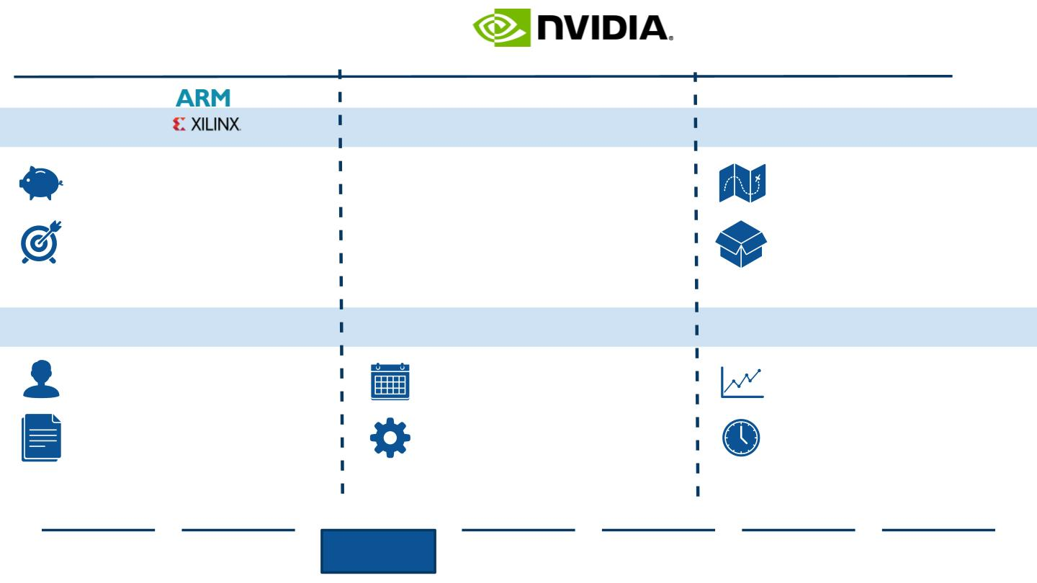
Strategic Fit Between Nvidia and AMD
AMD and Nvidia Current Operations Post-Integration
Sales Networks
Research and Development
Production and Network
Market Focus
AI Development
Shipping Efficiencies
●
●
Nvidia product line is more
expensive and tailored to
higher-end markets
AMD focuses on delivering at
minimal cost, appealing to
general consumer markets
●
●
Nvidia is ready to invest
upwards of $40B USD in AI seen
by ARM pending acquisition
AMD grabs Xilinx for $35B USD,
an acquisition most likely to go
through
●
●
Nvidia and AMD foundries are
located in the same regions of
Asia
Introduces supplier eﬃciencies
when packaging and
distributing product
AMD could assist Nvidia in expanding consumer
markets and introduce COGS cost savings.
AI resources may make both companies more
profitable as innovation accelerates.
Sharing suppliers can help achieve
sustainability goals for Supply Chains.
Partner Collaboration
Chip Expansion
Production Capacities
●
●
Nvidia’s Partner Network
provides a consulting approach
to develop business technology
AMD provides a partner library
with resources without
●
●
Nvidia rolls out a multi year
plan to develop new data
center chips
However some AMD foundries
cannot aﬀord manufacturing
new developments
●
Nvidia overcame production
constraints in Q3 2020 turning
to all time highs
However, AMD is seeing
another 6 months of chip
shortages because of demand
●
consulting
Partner program approaches are operated on
different scales so potential is limited.
Nvidia’s approach to R&D is diversified from
AMD so integration will be complex.
Nvidia could help AMD scale production
capabilities by scaling supplier networks.
Source: (Dent, 2018), (Ray, 2021), (Reuters, 2020)
Executive
Summary
Industry
Overview
Company
Analysis
Financial
Analysis
Acquisition
Feasibility
Alternative
Solution
Conclusion
27

Slide 28
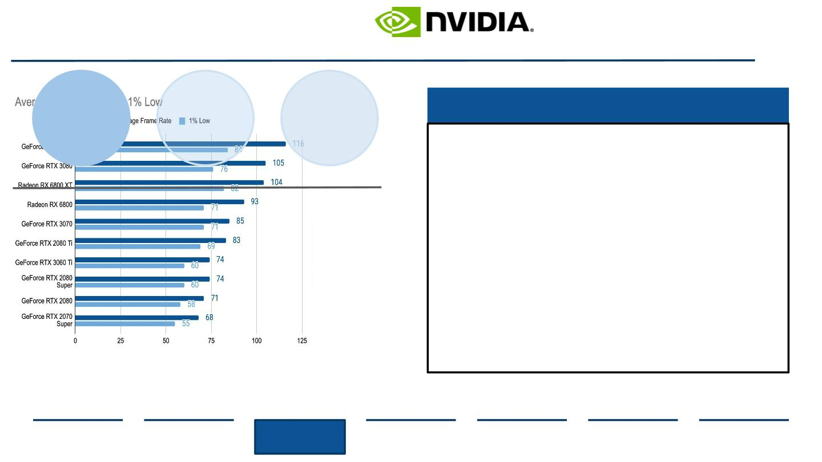
Strategic Fit
Quality Diﬀerences and Appealing to Diﬀerent Markets
Sales
Network
Supply
Chain
Foreseen Problems with Product Merger
R&D
●
On average a new product for Nvidia versus
AMD is 33% more expensive because of the
increased computing power each GPU
possesses
Market research shows buyers are “willing to
pay for a high functioning, dependable GPU”
The technology integrated in each GPU diﬀers
and impacts price drivers, eﬃciency, and
compatibility
Nvidia occupies 4/6 spots for best GPU frames per second
Nvidia’s GeForce series is the #1 GPU on the market
●
●
●
●
Many AMD devices can interact with Nvidia
components but not vice versa
Product merger may also make Nvidia’s brand
suﬀer as they compromise the quality and
eﬀectiveness of processors to minimize costs
Source: (Advanced Micro Devices, 2021), (Walton, 2020)
Executive
Summary
Industry
Overview
Company
Analysis
Financial
Analysis
Acquisition
Feasibility
Alternative
Solution
Conclusion
28

Slide 29
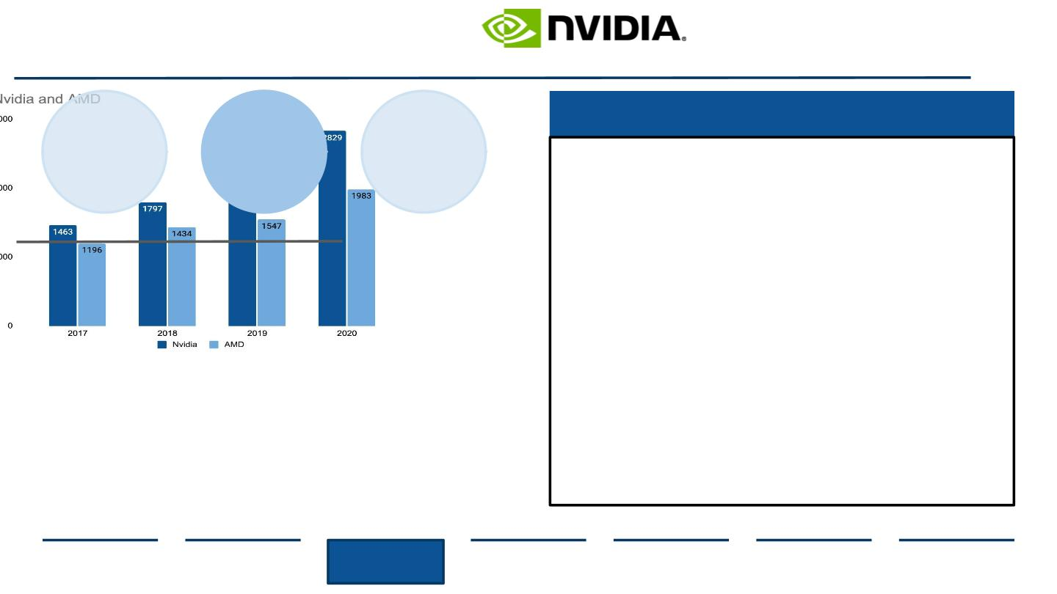
Strategic Fit
Research and Development Diﬀerences: Investment Segments Divide
Research and Development Focuses
Sales
Network
R&D
Supply
Chain
● AMD is keen on improving chip capabilities
through HPC, speciﬁcally in the growing
data center market along with industry
expansion
Nvidia is forecasted to uptick R&D 28% in 2021
R&D Spending, 2017-2020 USD Billions
● Nvidia is in the process of investing in new
chip development as seen with their 54
billion transistors AI chip released in 2020
● Integration of new devices and AI
technology in AMD’s sectors may waste
Nvidia’s resources in getting the company
up to speed
● Nvidia’s higher R&D spending allows for
creation of new computing capabilities
while AMD lower expenditures improve
existing infrastructure.
Source: (Advanced Micro Devices, 2021), (Nvidia, 2021)
Executive
Summary
Industry
Overview
Company
Analysis
Financial
Analysis
Acquisition
Feasibility
Alternative
Solution
Conclusion
29

Slide 30
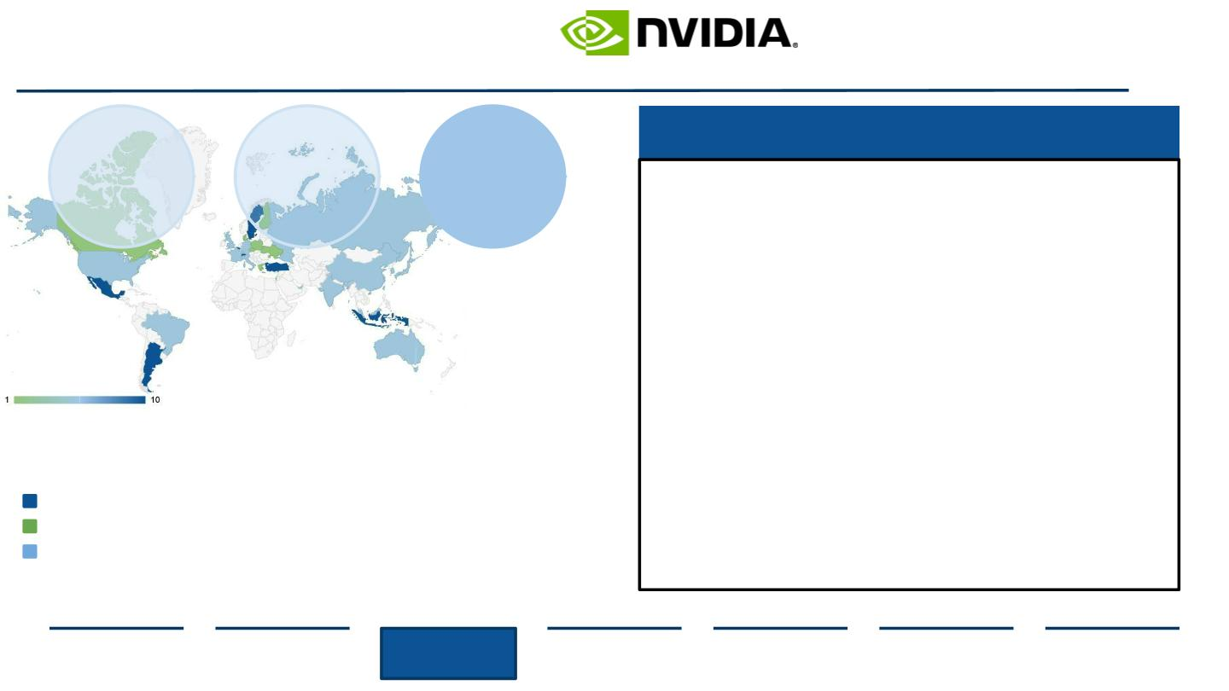
Strategic Fit
Expanding Production Capabilities
Combining Distribution Networks
Sales
Network
R&D
Supply
Chain
● Most semiconductor companies use the
same fabless process from the same
manufacturer and sourcing basic circuit
board components are homogenous
● TSCM supplies most of Nvidia’s
advanced components and AMD is
transitioning more processes to TSCM
● Most Supply Chain expenditures for AMD
and Nvidia come from distribution center
divisions and the inability to ﬁll a shipping
pallet
AMD Sites
● Combining operations may prove useful
when meeting unexpected demand
increases as seen in 2020
Nvidia Sites
Shared Sites
Source: (Craft Co., 2021), (Nvidia, 2021)
Executive
Summary
Industry
Overview
Company
Analysis
Financial
Analysis
Acquisition
Feasibility
Alternative
Solution
Conclusion
30

Slide 31

III. Financial Analysis
1
2
3
COMPARABLES
DISCOUNTED CASH FLOW
SYNERGIES
31

Slide 32
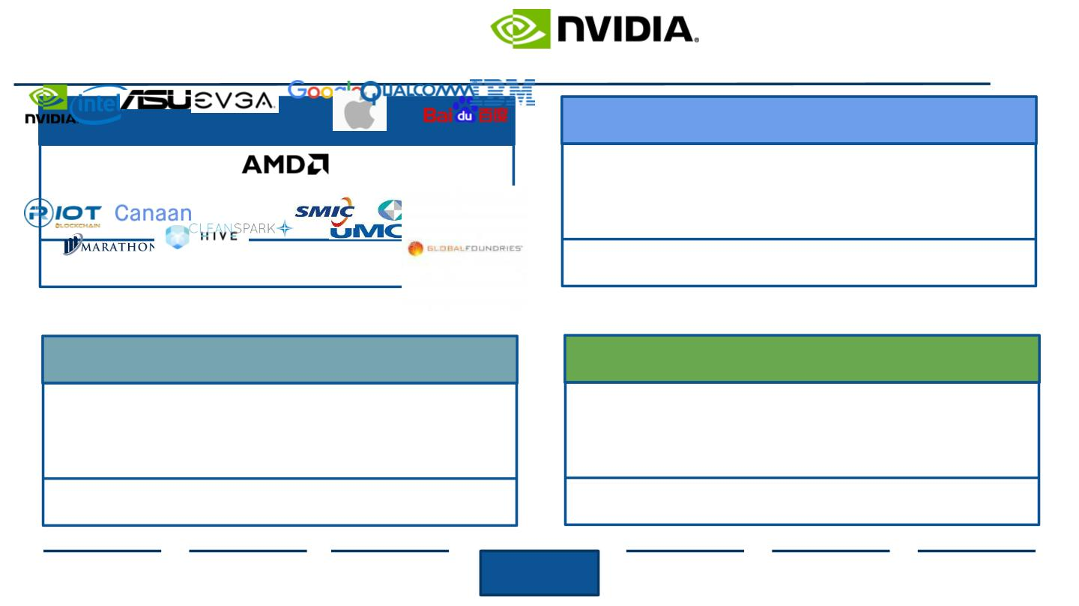
Advanced Micro Devices’ Potential Peer Groups
Our Peer Group Segments for AMD Consist of Visualization Graphics, Machine Learning in Data Centers,
Cryptomining, and Fabless Manufacturing
Visualization Graphics
Machine Learning in Data Centers
Logic: AMD’s main revenue driver is GPU sales and have one
of the highest GPU presence
Logic: Future trend and what most AMD R&D expenditure is
going towards
Crypto Mining
Fabless Manufacturing
Logic: Increase in GPU sales used in Bitcoin and Crypto Mining
tactics. Possible sector for AMD to explore.
Logic: Fabless manufacturing is source of innovation and R&D
growth as new designs affect computing power.
Source: (Infront Analytics, 2021), (Investopedia, 2019), (Oh, 2018)
Executive
Summary
Industry
Overview
Company
Overview
Financial
Analysis
Acquisition
Feasibility
Alternative
Solution
Conclusion
32

Slide 33
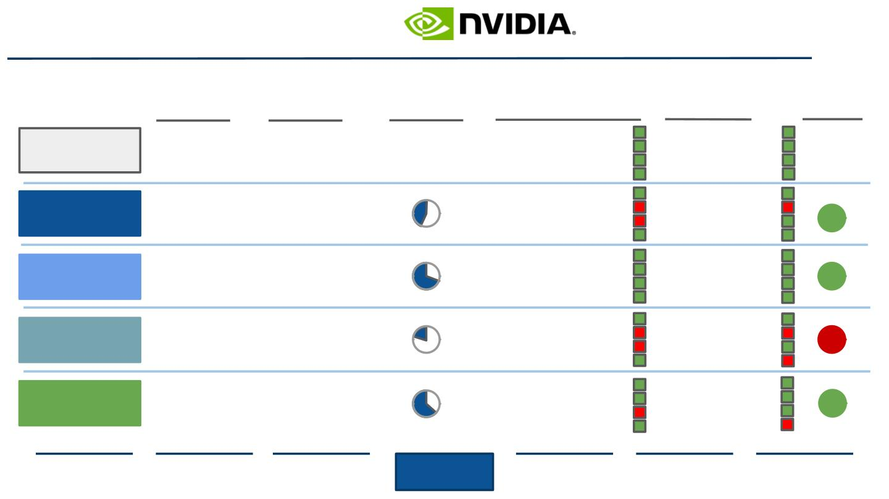
Advanced Micro Devices’ Peer Group Segment Relevance Analysis
Based on our Analysis, Fabless Manufacturing should be Discarded
Market Size
-
Market Size
CAGR
Brand
Relevance
Revenue Drivers
Cost Drivers
Retained
Advanced Micro
Devices
● Embedded Processors
● Semi Custom SoCs
● Server Microprocessors
● Services
● R&D
● Production Capability
● SG&A
8.93%
(‘18-’23)
-
● Licensing
● Embedded Processors
● Semi Custom SoCs
● Server Microprocessors
● Services
● R&D
● Production Capability
● SG&A
Visualization
Graphics
$1.48B
(‘19)
23.1%
(‘20-’27)
● Licensing
Machine
Learning in Data
Centers
● Embedded Processors
● Semi Custom SoCs
● Server Microprocessors
● Services
● R&D
● Production Capability
● SG&A
$6.59B
(‘20)
14.98%
(‘21-’26)
● Licensing
● Embedded Processors
● Semi Custom SoCs
● Server Microprocessors
● Services
● R&D
● Production Capability
● SG&A
Crypto Mining
$790mm
(‘18)
29.7%
(‘19-’25)
● Licensing
● Embedded Processors
● Semi Custom SoCs
Server Microprocessors
● R&D
● Production Capability
● SG&A
Fabless
Manufacturing
$127.9B
(‘20)
7.99%
(‘18-’22)
●
● Services
● Licensing
Source: (Deloitte, 2019), (Deutsche Bank, 2021), (Infront Analytics, 2021), (Trefis, 2021), (Reuters, 2020)
Executive
Summary
Industry
Overview
Company
Overview
Financial
Analysis
Acquisition
Feasibility
Alternative
Solution
Conclusion
33

Slide 34
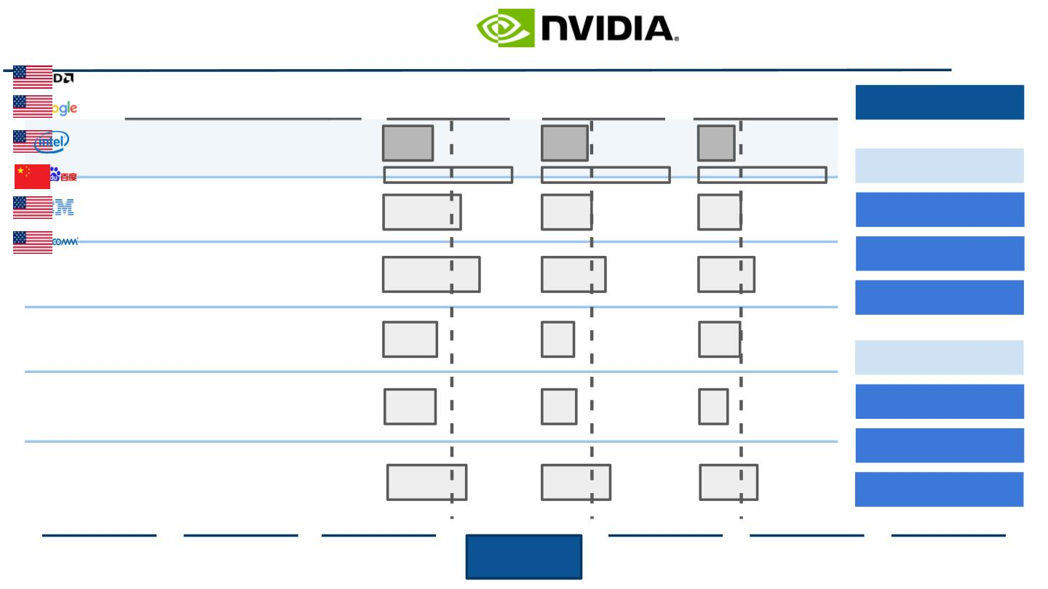
Advanced Micro Devices’ Peer Group Margins Analysis
EBITDA, EBIT, and Net Income Margin Projections for 2021
EBITDA margin
2021e
EBIT margin
Net Income Margin
2021e
Other segments
Relevance and Rationale
2021e
● Multinational SemiCon company
headquartered in Santa Clara, CA
● Specializing in GPU and CPUs
23%
21%
17%
Operations
Median: 32%
Median: 23%
Median: 20%
● Internet related service provider
● 5th most valuable company in the world
in big data and AI
36%
45%
23%
30%
20%
26%
Manufacturing
● Leading data center solutions company
● Growing in R&D chip development
Production Location
Business Alignment
● Internet related services companies
headquartered in Beijing, China
● One of the largest AI developers
25%
24%
15%
16%
19%
13%
Finance
R&D
● Technology hardware producer/seller
● Pioneers Watson- a Q&A computing
system integrated with AI
Size
● Mobile communications ﬁrm with critical
comm standards patents
● Increasing AI expenditures in mobile
computing
37%
32%
27%
Growth Margins
Source: (Advanced Micro Devices, 2020), (Baidu, 2021), (Evercore ISI, 2021), (J.P. Morgan, 2021), (Morgan Stanley, 2021)
Executive
Summary
Industry
Overview
Company
Overview
Financial
Analysis
Acquisition
Feasibility
Alternative
Solution
Conclusion
34

Slide 35
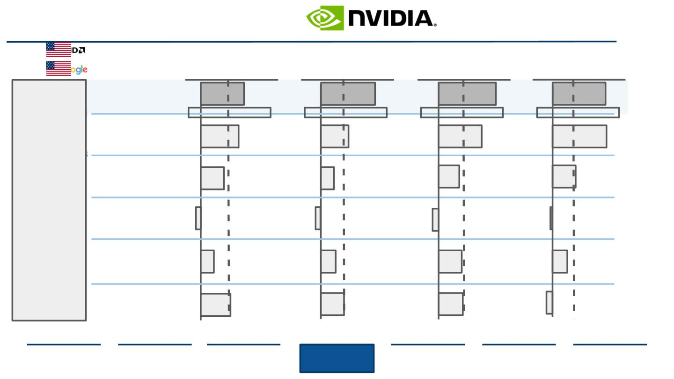
Peer Group Trading Multiples
For Machine Learning in Data Centers
EV/EBITDA
EV/EBITDA
2021e
EV/EBIT
2021e
EV/AI Patents
2021e
2021e
7.1
31.7
34.6
144
Median: 3.95
Median: 12.9
Median: 16.5
Median: 67.4
6.2
3.8
16.8
8.2
26.3
12.6
146
63
Machine
Learning
in Data
Centers
-0.5
2.2
-2
-3.4
14.1
-0.9
37.3
15.0
9.3
4.9
13.4
14.7
Source: (Advanced Micro Devices, 2020), (Baidu, 2021), (Evercore ISI, 2021), (J.P. Morgan, 2021), (Morgan Stanley, 2021), (Statista, 2019)
Executive
Summary
Industry
Overview
Company
Overview
Financial
Analysis
Acquisition
Feasibility
Alternative
Solution
Conclusion
35

Slide 36
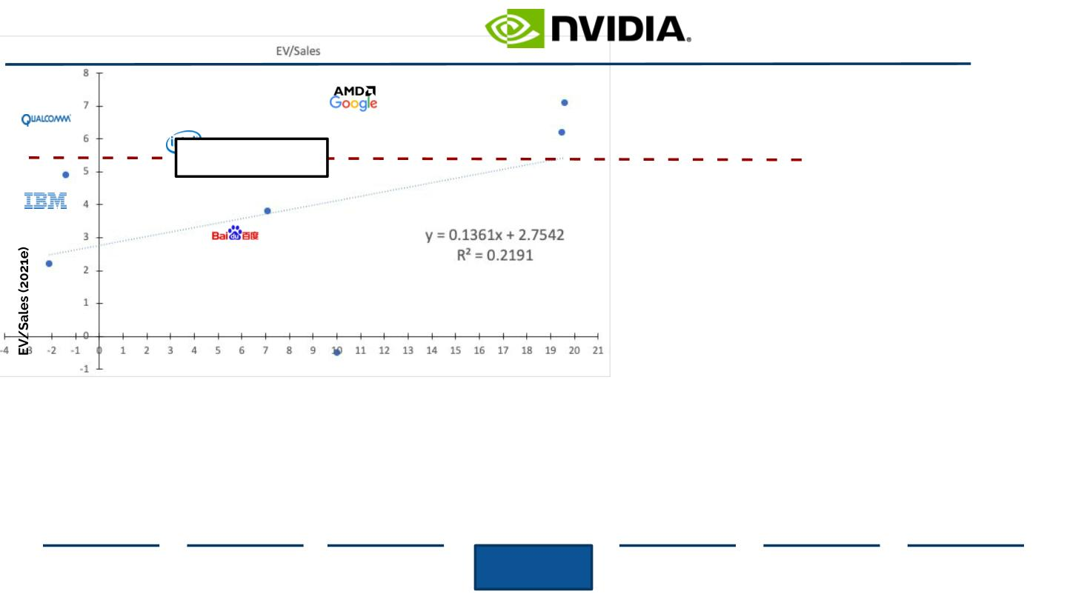
EV/Sales vs. Sales CAGR
Multiples and Sales CAGR Comparison amongst AMD’s Peer Group
EV/Sales (2021e) vs Sales CAGR (2018-2023e)
Takeaways
Current Market: 7.16
AMD’s 2021e EV/Sales is
at the current market
level of 7.16x.
Based on AMD’s Sales
CAGR (2018-2023e), the
Company has a higher
revenue growth rate
than its peers, with the
most comparable ﬁrm
being Google.
However, AMD’s
relatively high EV/Sales
compared to its peers
indicates that the
Company is overvalued.
Sales CAGR (2018-2023e)
Source: (Reuters, 2020)
Executive
Summary
Industry
Overview
Company
Overview
Financial
Analysis
Acquisition
Feasibility
Alternative
Solution
Conclusion
36

Slide 37
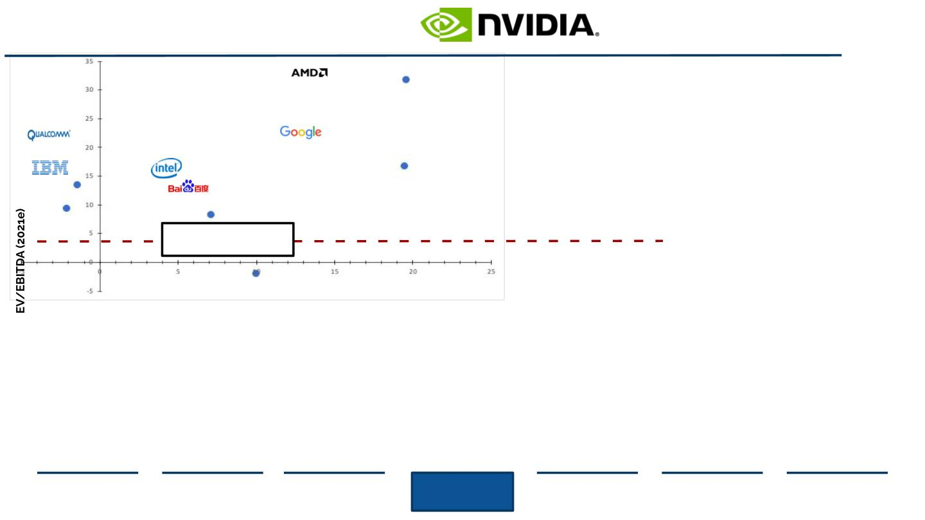
EV/EBITDA vs. Sales CAGR
Multiples and Sales CAGR Comparisons amongst AMD’s Peer Group
EV/EBITDA (2021e) vs Sales CAGR (2018-2023e)
Takeaways
AMD’s 2021e EV/EBITDA is
trading much higher than
the current market
multiple of 18.01x.
Furthermore, all of AMD’s
peer groups are trading at
a multiple below the
current market line.
Current Market: 18.01
AMD’s relatively high
EV/EBITDA multiple
demonstrates
overvaluation of the
Company compared to its
peer groups and the
current market.
On both EV/Sales and
EV/EBITDA metrics, AMD
is signiﬁcantly overvalued.
Sales CAGR (2018-2023e)
Source: (Reuters, 2020)
Executive
Summary
Industry
Overview
Company
Overview
Financial
Analysis
Acquisition
Feasibility
Alternative
Solution
Conclusion
37

Slide 38
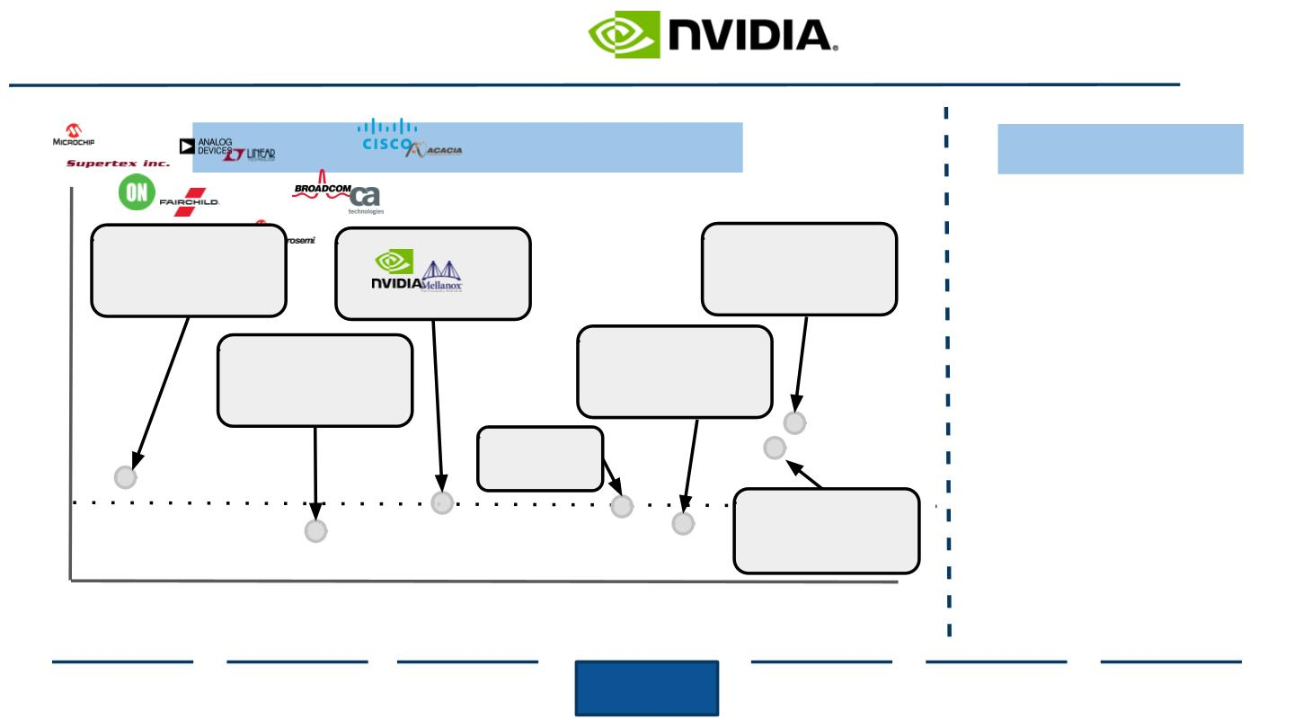
Comparable M&A Transaction Multiples
AI and Machine Learning Semiconductor Development
Past Transaction Multiples: LTM EV/EBITDA
EV/EBITDA
Takeaways
Although
comparable
80x
EV/EBITDA M&A multiples can
give a rough estimation of AMD’s
value after the potential NVDA
acquisition, they are not the most
accurate metric because…
acquires
acquires
acquires
70x
60x
50x
40x
30x
20x
10x
0
acquires
acquires
1.
Sizes
of
the
targeted
companies
in
comparable
transactions can vary signiﬁcantly
2. Premiums paid to acquire these
target companies could vary
greatly in the case of AMD/NVDA
acquires
Median: 19.4x
acquires
3. Synergies also diﬀer on a case
to case basis, as each company
has its own unique oﬀerings
2014
2015
2016
2017
2018
2019
2020
Source: (Capital IQ, 2021), (Reuters, 2020)
Executive
Summary
Industry
Overview
Company
Overview
Financial
Analysis
Acquisition
Feasibility
Alternative
Solution
Conclusion
38

Slide 39

III. Financial Analysis
1
2
3
COMPARABLES
DISCOUNTED CASH FLOW
SYNERGIES
39

Slide 40
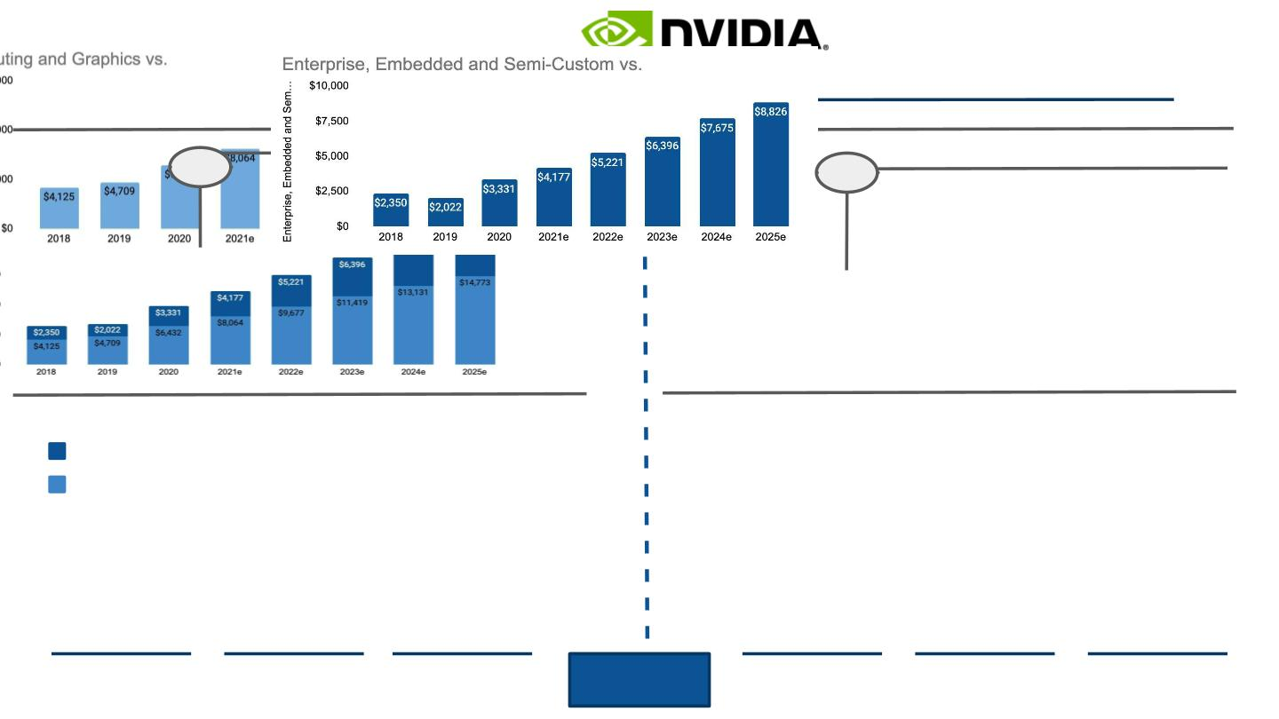
Revenue Breakdown
Business Segment Revenue Growth Projections through 2025
Segment Revenue is expected to grow by 56% between 2020-2025
Semi-C Revenue is expected to grow by 63% between 2020-2025
Predicted Computing and Graphics Revenue 2020-2025
Predicted Enterprise, Embedded and Semi-Custom Revenue 2020-2025
56%
63%
Combined Revenue is expected to grow by 56% between 2020-2025
Revenue Breakdown
Predicted Total Revenue 2020-2025
Both Segment and Total Revenue Forecasts Trend Upward
Enterprise, Embedded and Semi-Custom
Computing and Graphics
●
●
●
●
Each segment’s revenue forecasts demonstrate steady upward
growth through 2025, resulting in cumulative revenue increases
These trends demonstrate continued demand for AMD’s product and
service lines for years to come
Computing and Graphics segment is expected to exhibit higher total
sales, generating an estimated $14,773 in 2025
Semi-C segment is expected to grow at an accelerated rate while
contributing adequate revenue to AMD, with an estimated $8,826 in
sales for year 2025
Source: (Reuters, 2020), (Witkowski, 2021), (WSTS, 2020)
Executive
Summary
Industry
Overview
Company
Overview
Financial
Analysis
Acquisition
Feasibility
Alternative
Solution
Conclusion
40

Slide 41
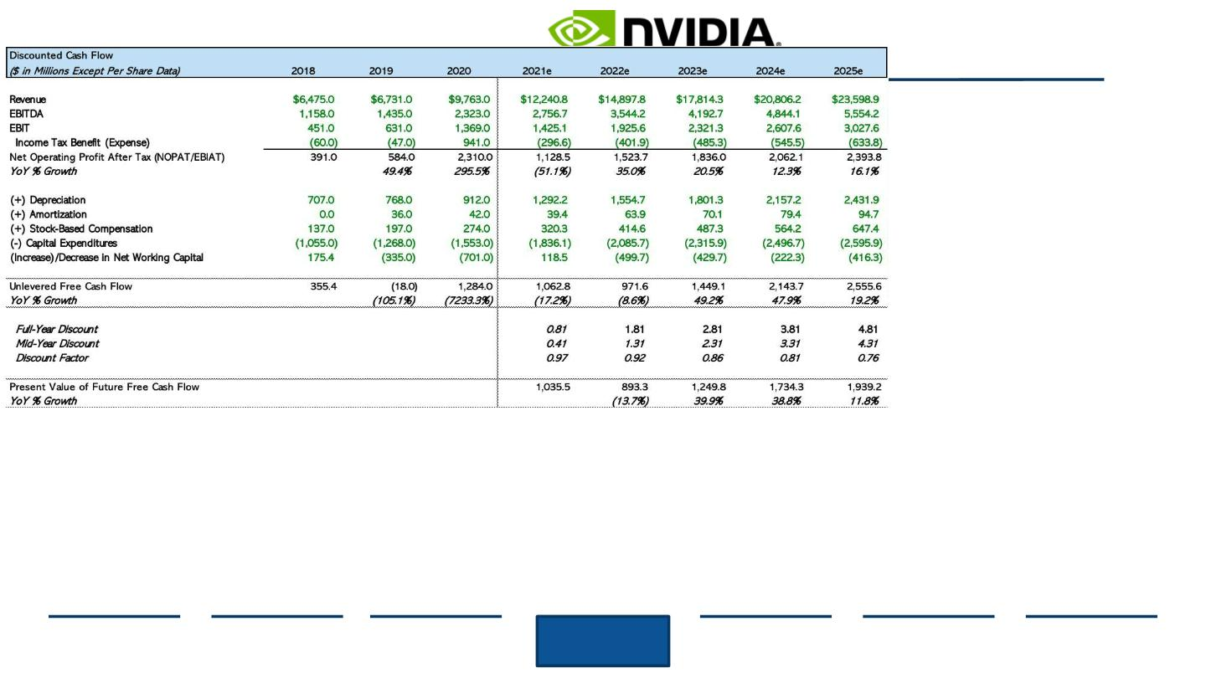
Discounted Cash Flow (Part 1)
Valuation of AMD
Source: (Capital IQ,2020)
Executive
Summary
Industry
Overview
Company
Overview
Financial
Analysis
Acquisition
Feasibility
Alternative
Solution
Conclusion
41

Slide 42
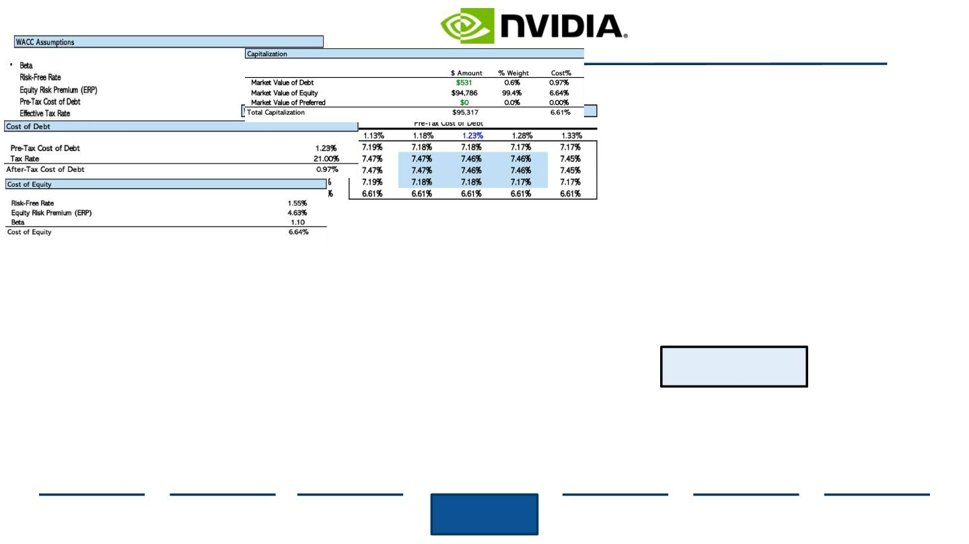
Discounted Cash Flow (Part 2)
WACC Calculation
WACC Assumptions
Total Capitalization
WACC Sensitivity Analysis
Cost of Debt Calculation
Cost of Equity Calculation
WACC = 6.61%
●
●
●
The Weighted Average Cost of Capital (WACC) represents return to
lenders and shareholders.
AMD’s WACC of 6.61% represents the required rate of return (discount
rate) necessary for DCF analysis.
Furthermore, it indicates that the Company must pay investors an
average of $0.0661 for every $1 received in funding.
Source: (Capital IQ,2020)
Executive
Summary
Industry
Overview
Company
Overview
Financial
Analysis
Acquisition
Feasibility
Alternative
Solution
Conclusion
42

Slide 43
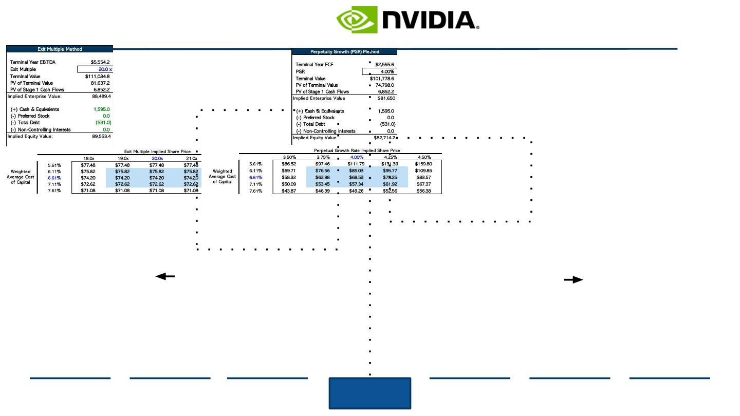
DCF Sensitivity Analysis
Exit Multiple and Perpetual Growth Rate (PGR) Method
Exit Multiple Method
Calculation of Implied EBITDA Multiple
Perpetual Growth Rate (PGR) Method
Calculation of Implied Terminal Growth Rate
Exit Multiple Method is
used to calculate the
terminal value of the
Company’s FCFs, under
the assumption that
business value will be
determined at the end
of the projection period.
Perpetual Growth Rate
Method assumes a
constant rate of cash
ﬂow generation into
perpetuity.
Source: (Capital IQ, 2020)
Executive
Summary
Industry
Overview
Company
Overview
Financial
Analysis
Acquisition
Feasibility
Alternative
Solution
Conclusion
43

Slide 44
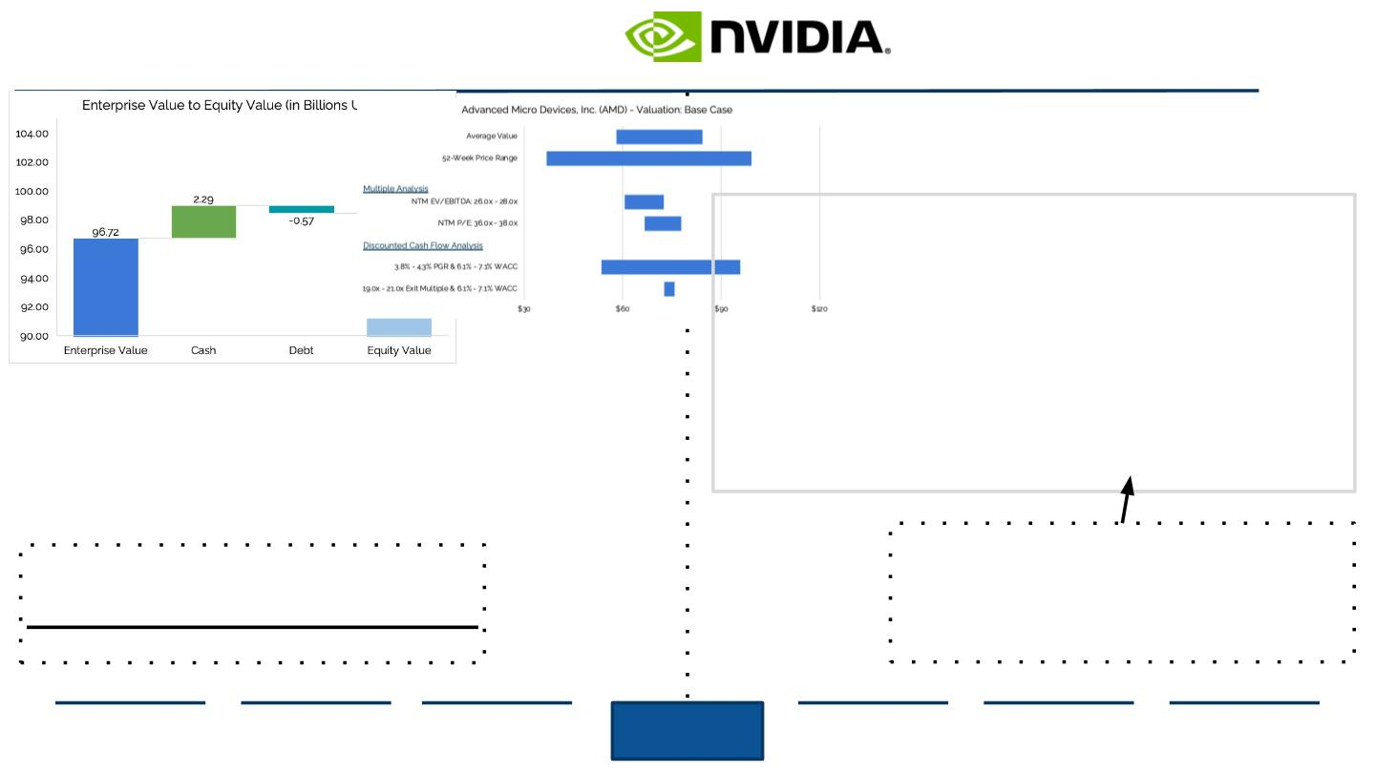
Fair Enterprise Value Determination
Enterprise to Equity Value Bridge and Football Field EV Range
Enterprise to Equity Value Bridge
Waterfall Chart (in billions of USD)
Football Field
Fair Enterprise Value (in billions of USD)
Estimated Fair EV Range: $70-75B
Enterprise Value (2020A): $96.72B
+ Cash and ST Investments: $2.29B
- Total Debt: $0.57B
Average Fair EV: $72.5B
Therefore, AMD’s intrinsic value is lower than its market
value of ~$97B, signifying overvaluation.
Equity Value: $98.43B
Source: (Capital IQ, 2020)
Executive
Summary
Industry
Overview
Company
Overview
Financial
Analysis
Acquisition
Feasibility
Alternative
Solution
Conclusion
44

Slide 45
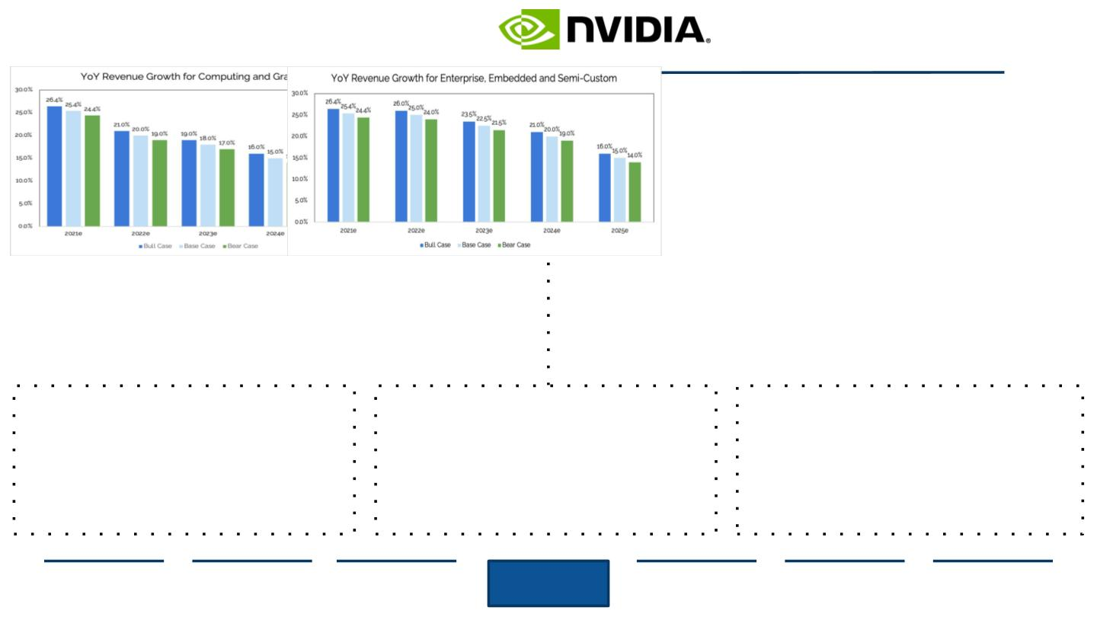
Scenario Analysis
Bear, Base, and Bull Revenue Growth Projections for AMD’s Business Segments
Computing and Graphics Segment
YoY Revenue Growth Projections (%)
Enterprise, Embedded, and Semi-Custom Segment
YoY Revenue Growth Projections (%)
BEAR CASE SCENARIO
1. GLOBAL CHIP SUPPLY:
BASE CASE SCENARIO
1. GLOBAL CHIP SUPPLY:
BULL CASE SCENARIO
1. GLOBAL CHIP SUPPLY:
the global chip shortage fails to subside and production falls
2. PRODUCT PRICING:
the global chip shortage slowly subsides and supply continues to
restore
the global chip shortage subsides faster than expected and supply
skyrockets
due to supply shortages, price per product skyrockets and
decreases consumer demand
3. COMPETITION IN THE MARKET:
2. PRODUCT PRICING:
price charged per product remains the same as supply grows
3. COMPETITION IN THE MARKET:
2. PRODUCT PRICING:
due to large amounts of supply, lower prices are charged and
consumer demand booms
due to intense competition within semiconductors, AMD loses
market share and faces further reductions in demand
AMD maintains a fairly constant slice of the semiconductor market
and continues to face similar competitive pressures
3. COMPETITION IN THE MARKET:
AMD claims a larger market share and demand grows further
Source: (Advanced Micro Devices, 2020), (Capital IQ, 2020), (Trefis, 2021)
Executive
Summary
Industry
Overview
Company
Overview
Financial
Analysis
Acquisition
Feasibility
Alternative
Solution
Conclusion
45

Slide 46

III. Financial Analysis
1
2
3
COMPARABLES
DISCOUNTED CASH FLOW
SYNERGIES
46

Slide 47
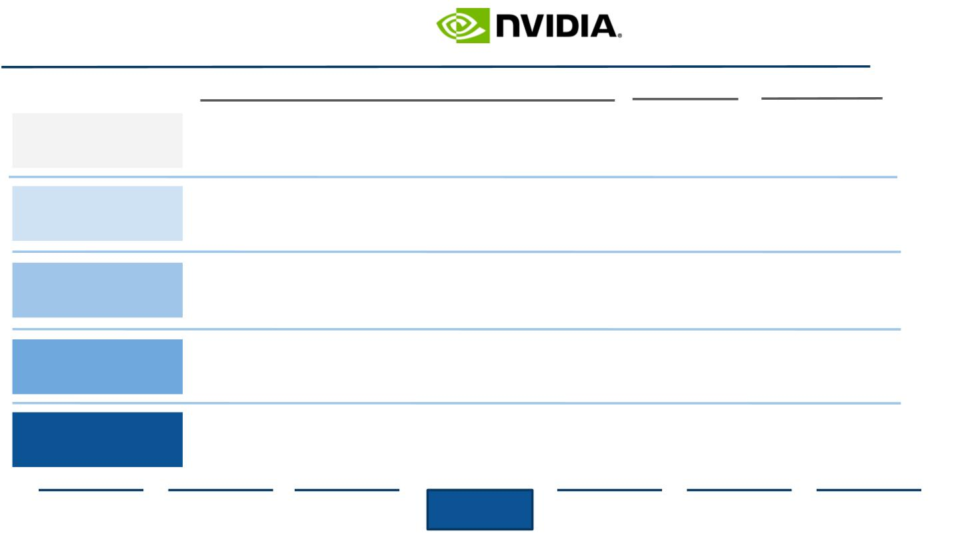
Synergies Overview
Analysis of Potential Synergies for Nvidia and AMD
Nvidia and AMD Possible Synergies
Duration
Explanation
●
●
Analyze crossfunctions within the organizations to eliminate overlap
and unnecessary management
Identify regional headquarters and oﬃces for integration
●
●
Analysis next
Cost reduction,
hard to calculate
Corporate Functions
Sales Network
1-3 yrs
●
●
Proﬁt divisions based on product to see overlap of design process
See combination of processing units to re-evaluate procurement
initiatives
●
●
Segmentation not
visible
Long term
1-3 yrs
5-7yrs
●
●
Use of AMD licenses and patent to scale innovation
Reduce cost drivers of production and increase product
portfolio
IT Systems
●
Diﬀerent product
design
Analysis next
Long term
Research and
Development
●
●
●
●
●
Utilize same suppliers and manufacturers to increase production
AMD products being distributed through Nvidia shipping/sales
channels scaling
●
●
Logistics complications
Wider access to
consumer markets
Distribution
3-5yrs
●
●
Productivity measure
Specialized AMD partner
programs diﬃcult to
integrate
Post-Merger
●
●
Employee relationship management
Partner recognition reevaluation and service terms
Lifelong
Source: (Ashkenas, 2019)
Executive
Summary
Industry
Overview
Company
Overview
Financial
Analysis
Acquisition
Feasibility
Alternative
Solution
Conclusion
47

Slide 48
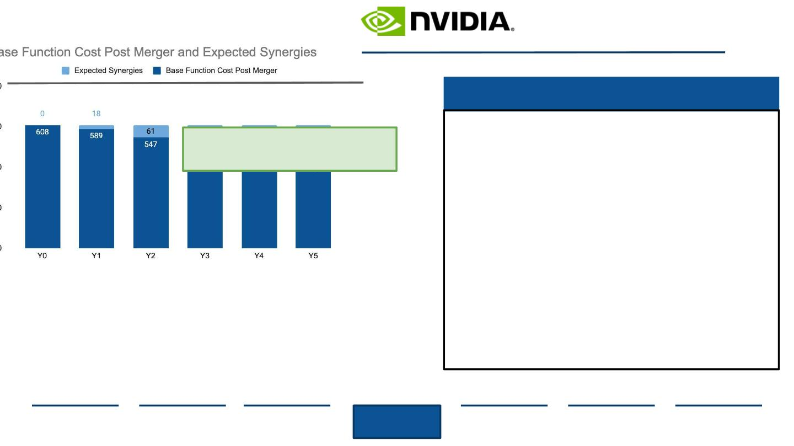
Removing Overlapping Corporate Functions
Restructuring Post-Merger Could Lead to a 20-30% Cut of Repetitive Roles within Two Years
A Merger could prove cost eﬀective when combining similar jobs
Estimated Cost Savings Post Merger Y0-Y5, Millions USD
Eliminating Cross Functions
Potential Savings:
Initial base corporate functions for Nvidia and AMD estimated
from total SG&A expenses. Assuming 25% is manufacturing costs.
Nvidia (FY2020) totals 1,435M USD and AMD totals 905M USD.
Combined with 25% for base roles is 608 M USD
● Overlap of functions is 3% during merger
initiation and 30% in Year 5 post merger
integration
● In addition to people, automation and
system combinations in cross functions
are combined thus allowing for cheaper
measures and higher visibility in teams
● People management is highlight and
impact driver for revenue/employee
synergies
● Reduction in executive compensation
allocated but some positions cannot
eliminate like CEO and other C-Suite
Source: (Advanced Micro Devices, 2021), (Harvard Business Review, 2016)
Executive
Summary
Industry
Overview
Company
Overview
Financial
Analysis
Acquisition
Feasibility
Alternative
Solution
Conclusion
48

Slide 49
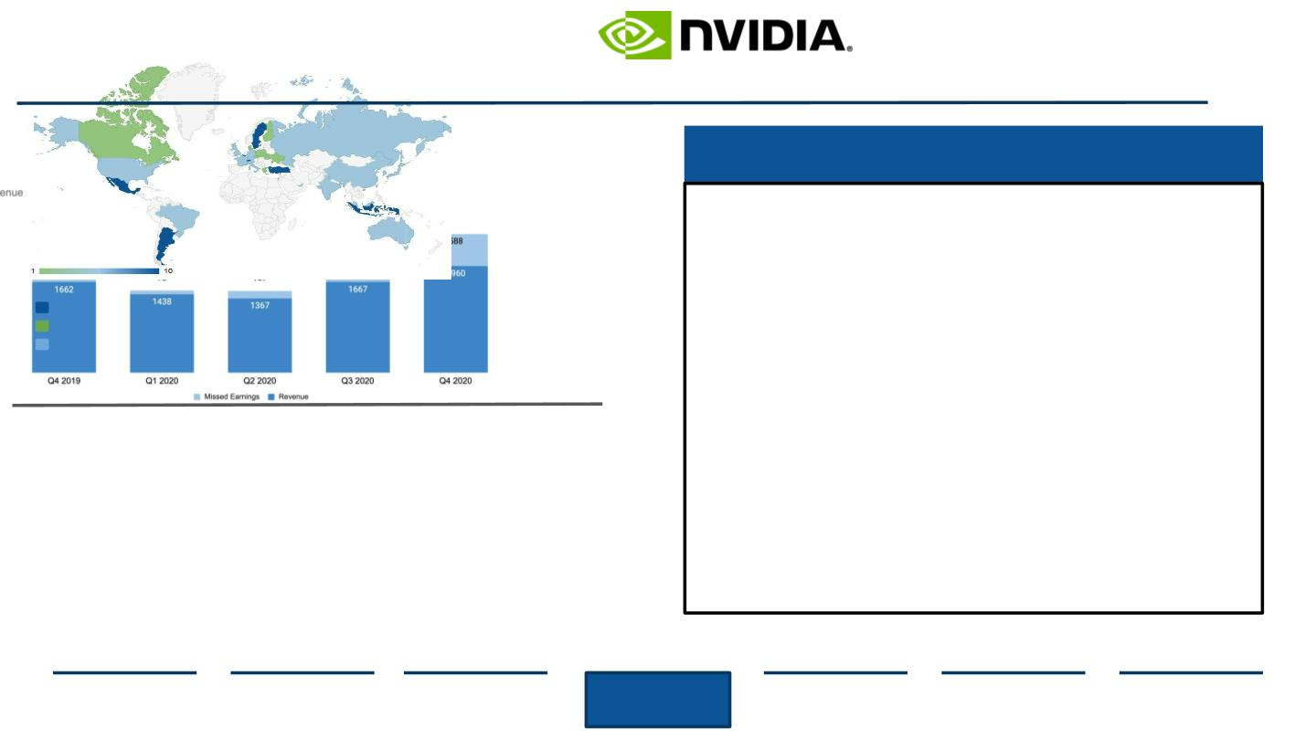
Increasing Production Capabilities and Locations
The current chip deﬁcit is a global shortage heavily aﬀecting GPU and AI industries. Combining operations allows
for more Supply Chain capabilities and agility.
Combining Distribution Networks
● Most semiconductor companies use the
same fabless process from the same
manufacturer and sourcing basic circuit
board components are homogenous
● TSCM supplies most of Nvidia’s advanced
components and AMD is transitioning more
processes to TSCM
● Most Supply Chain expenditures for AMD
and Nvidia come from distribution center
divisions and the inability to ﬁll a shipping
pallet
AMD Sites
Nvidia Sites
Shared Sites
Chip Shortage Demand Outstrips AMD Supply by 30 Percent
AMD Quarterly Revenue and Missed Earnings, 2019-2020, Millions USD
● Combining operations may prove useful
when meeting unexpected demand
increases as seen in 2020
Source: (Craft Co., 2021), (Hruska, 2021), (Nvidia, 2021)
Executive
Summary
Industry
Overview
Company
Overview
Financial
Analysis
Acquisition
Feasibility
Alternative
Solution
Conclusion
49

Slide 50
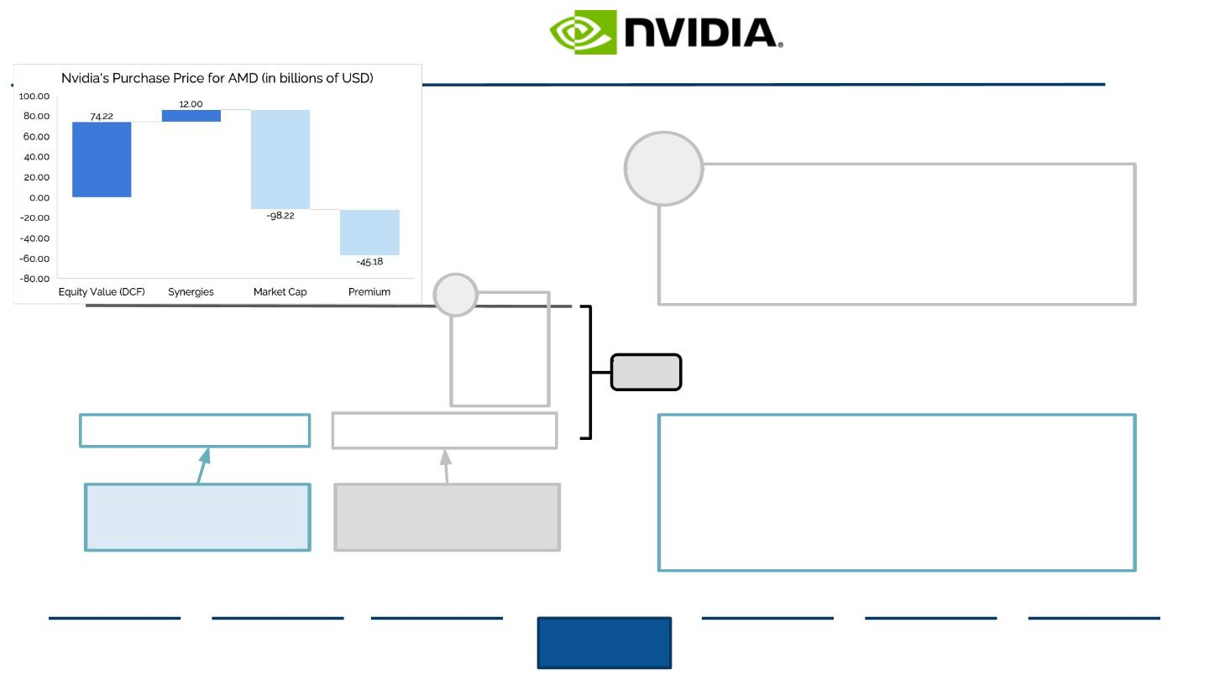
Purchase Price of AMD
If Nvidia were to Acquire AMD, the Company would Suﬀer a Financial Loss of $57.18B
1
Premium
-
-
The average M&A premium paid within the
Semiconductor industry is 46%
Based on this value, the premium that NVDA
would pay to acquire AMD is equivalent to $45.18B
1
$57.18B
Additional Takeaways
-
Considering the large amount of debt/liabilities that
Nvidia has based on 2021A ﬁnancial data, it would be
unwise for the Company to pay such a large premium
for AMD—in addition to the target’s overvaluation on a
multiples and EV basis.
Estimated Value of AMD
Estimated Purchase
Price of AMD
Source: (Capital IQ, 2020)
Executive
Summary
Industry
Overview
Company
Overview
Financial
Analysis
Acquisition
Feasibility
Alternative
Solution
Conclusion
50

Slide 51

IV. Acquisition Feasibility
Functionality of
Company Integration
51

Slide 52
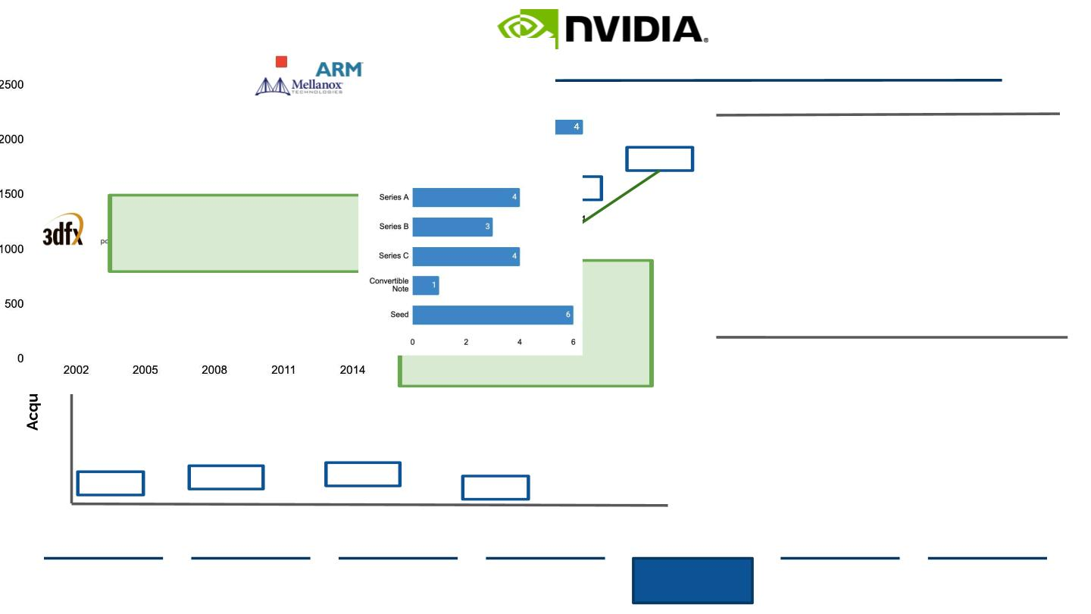
Nvidia’s Past Acquisitions Forecast Future Mergers
Nvidia has gone through 17 total acquisitions. Most are ﬁnanced in late stage.
Nvidia’s Prime Acquisitions Lead to Control over the GPU Space
Nvidia’s Major Acquisitions and Mergers 2002-2020
Nvidia Acquisitions by Stage Funding
Most Acquisitions occurred in Late Stage Funding
7
40 B
7 B
6
The key to Nvidia’s acquisitions is
vertically enhancing their value
chain going from a chip company to
a data center-scale company
5
4
In 2020, Nvidia announced its
acquisition of ARM Holdings, making
headway into the AI space. The
proposed deal is met with much
scrutiny from regulators pending
investigation.
Nvidia Investing Stages
Most Investments Occurred in the Seed Stage
3
2
1
70 mm
357 mm
375 mm
3.8 mm
2002
2004
Source: (Crunchbase, 2021), (Reif, 2020)
Executive
Summary
Industry
Overview
Company
Overview
Financial
Analysis
Acquisition
Feasibility
Alternative
Solution
Conclusion
52

Slide 53
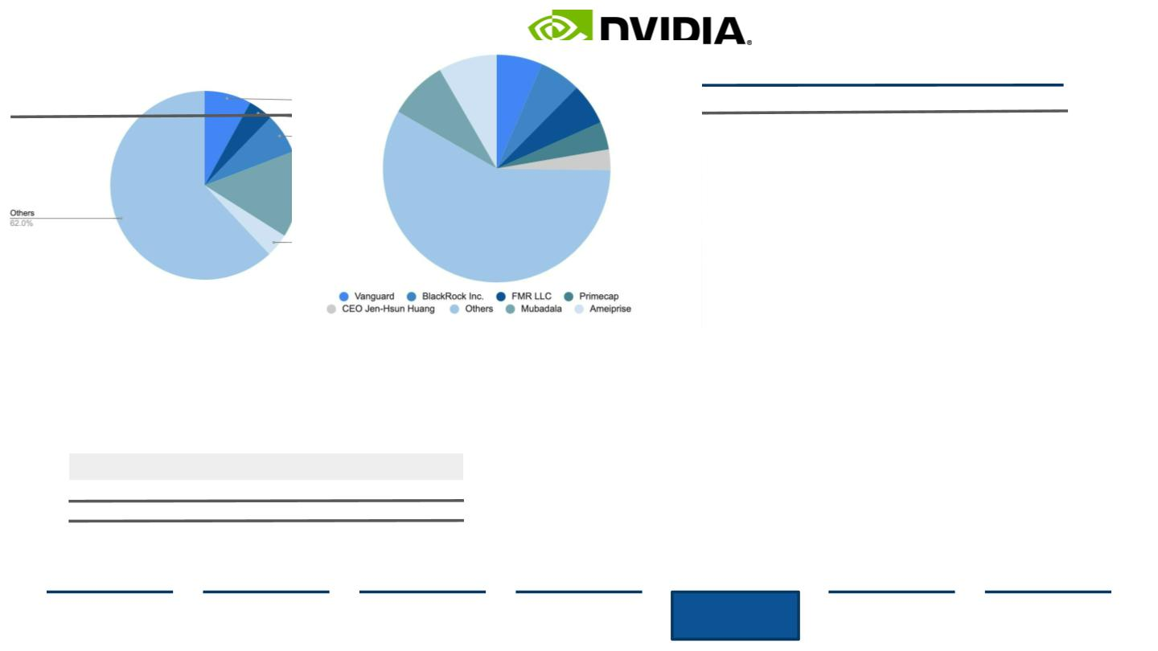
Company Ownership Structure
Crosses between AMD and Nvidia ownership may lead to easier merger
AMD Current Ownership Structure
Based oﬀ Percent of Market Capitalization, March 11,2021
Change in Nvidia’s Ownership Structure, Before and After
Based oﬀ Percent of Market Capitalization, March 11,2021
Before
After
Market Cap: $98.17B
8%
13%
8%
7%
9%
70%
5%
3%
47%
12%
12%
2%
2%
3%
Assumptions
● Financial institutions like Vanguard, BlackRock Inc.,
and FMR had investments in both AMD and Nvidia
● Shareholder integration may prove to be easier
since no one person/ﬁrm holds the majority
AMD market capitalization:
Nvidia market capitalization:
Acquisition premium:
98.17B as of 3/11/21
318.83B as of 3/11/21
46%
Source: (Advanced Micro Devices, 2021), (CNN, 2021), (Fintel, 2021), (Nvidia, 2021)
Executive
Summary
Industry
Overview
Company
Overview
Financial
Analysis
Acquisition
Feasibility
Alternative
Solution
Conclusion
53

Slide 54
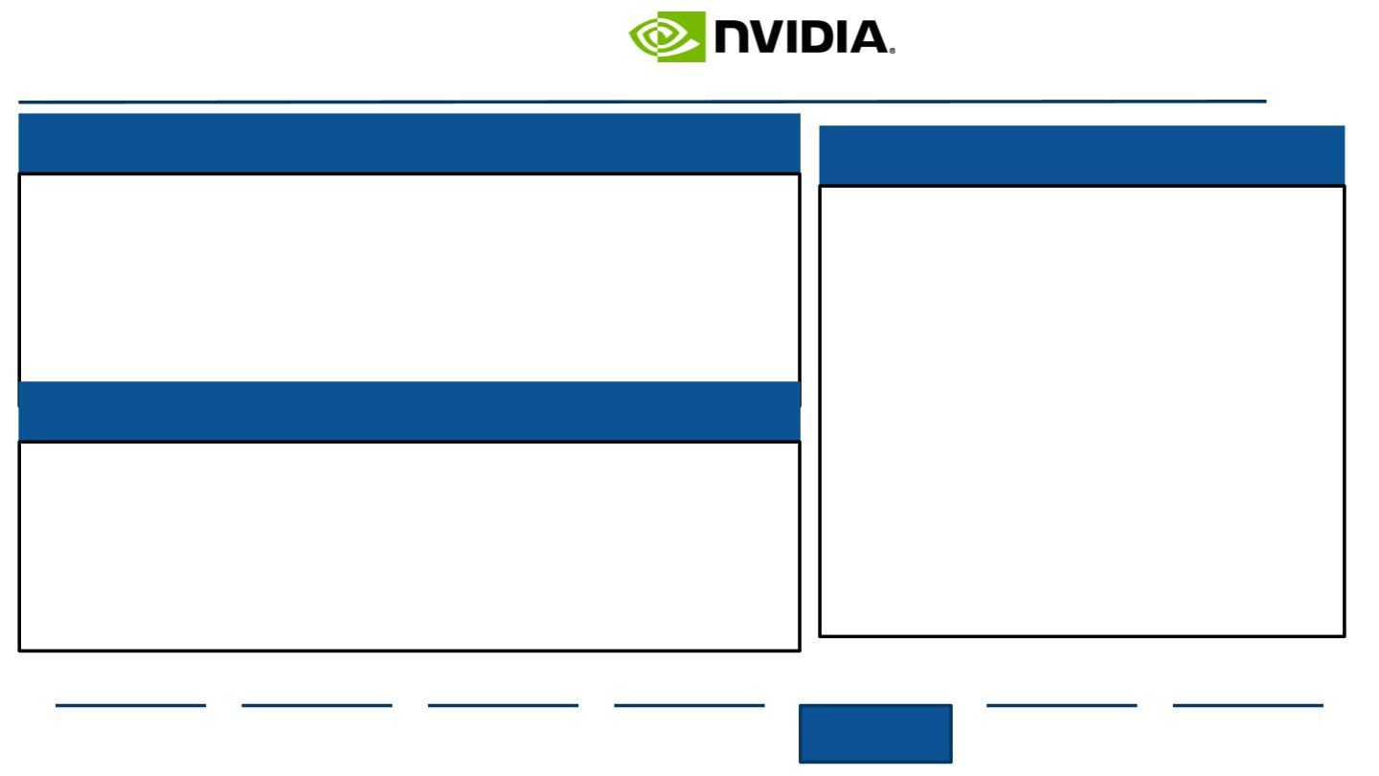
Other Considerations
Several other Hindrances Pose a Threat to Nvidia Post-Acquisition
Antitrust Regulation- Low threat
Retaining Company Culture
●
●
This acquisition could increase Herﬁndahl-Hirschman Index
to a dangerous concentration level if overall market is
controlled
Vertical acquisitions like Nvidia/AMD are usually under
lower scrutiny from the Federal Trade Commission and the
Department of Justice
●
●
Innovation and data-orientedness is
the foundation of Nvidia
Acquisition should reﬂect the pursuit
of new R&D and the foundational
value of advancement
AMD’s R&D is not as developed
Shifts in structure may receive
negative reception from AMD, with
employee satisfaction at 84%
according to a survey study
conducted by Comparably
Cultural alignment drives revenue, as
morale directly increases
●
●
Debt Accrual
●
●
●
New debt ﬁnancing for new merger or acquisition is needed
because strictly cash is not feasible
Nvidia has increased debt margins over the years with
increases in 192% from FY 2020-FY 2021
Debt ﬁnancing can lead to decreased credit score for
company if future loans need to be taken out
●
productivity
Source: (Nvidia, 2019), (Nvidia, 2020), (Nvidia, 2021)
Executive
Summary
Industry
Overview
Company
Overview
Financial
Analysis
Acquisition
Feasibility
Alternative
Solution
Conclusion
54

Slide 55
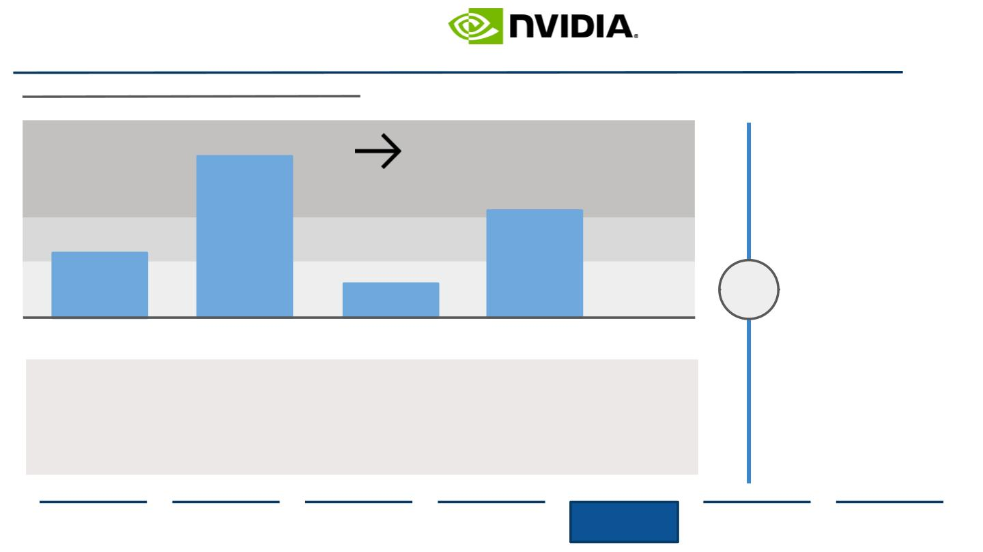
Legal and Antitrust Regulation
The Federal Trade Commission May Approve a Merger based on HHI
Analysis of concentration of various markets
Herﬁndahl-Hirschman index for selected US markets
Conclusion
Concentration
● The semiconductor
industry has a
Level
6200
Herﬁndahl-Hirschman
Index of 2,478 which is
considered by antitrust
regulations to be
moderately
High
4100
Medium
Low
2478
concentrated
790
● A merger between
Nvidia and AMD would
increase the HHI Index
to 2,486, meaning a
merger between the
two would be under
low scrutiny by the
FTC or DOJ
Semiconductor
Retail
Smart
Phones
Mobile
Broadband
Trust Regulations
●
●
Sherman Antitrust Act- prohibits companies from monopolizing and controlling overall market
Hart-Scott-Rodino Antitrust Improvements Act- companies must go through FTC to gain approval for an M&A
transaction to see if results would adversely impact US businesses in same segment
Clayton Act- illegal for company to purchase stock of another post-acquisition, resulting in reduced industry
competition
●
Source: (Britannica, 2021), (Statista, 2020)
Executive
Summary
Industry
Overview
Company
Overview
Financial
Analysis
Acquisition
Feasibility
Alternative
Solution
Conclusion
55

Slide 56
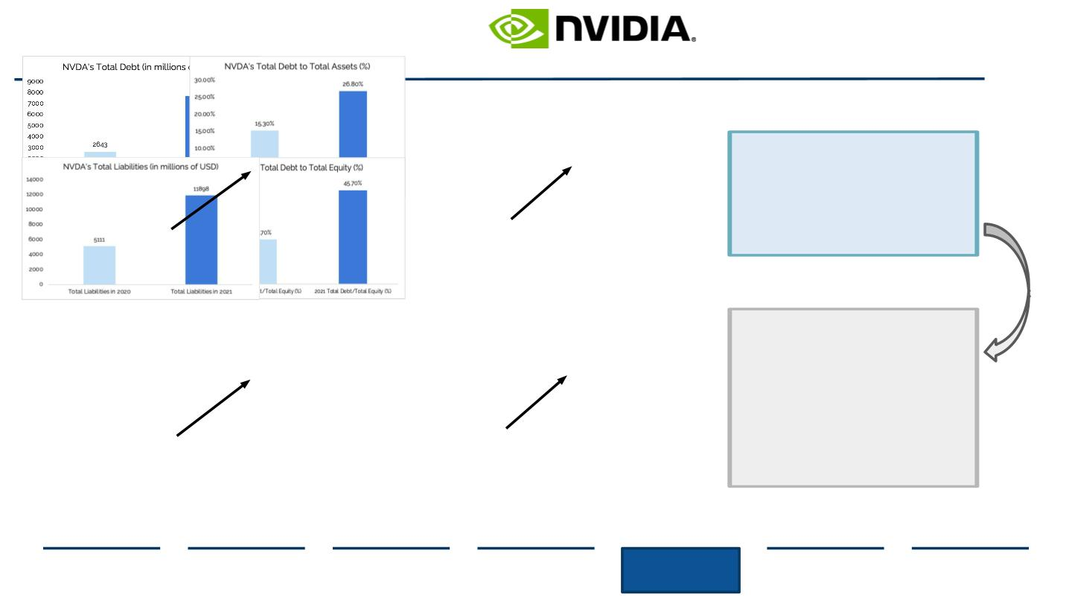
Debt Financing Feasibility
Given Nvidia’s 2021 Total Debt and Liabilities, Debt-Financing is Unfeasible
In 2021, Nvidia’s total debt grew
192% from $2643mm to
$7718mm. Consequently, total
liabilities grew 133% from
$5111mm to $11,898mm. Net
debt grew 53.4% YoY.
+192%
+11.5%
Due to Nvidia’s recent spike in debt,
acquiring AMD through debt
ﬁnancing would be
unfeasible—causing an overload of
debt (thus reducing FCF available
for spending in other areas) and
potentially harming the Company’s
current S&P credit rating of A-.
+133%
+24%
Source: (Nvidia, 2021)
Executive
Summary
Industry
Overview
Company
Overview
Financial
Analysis
Acquisition
Feasibility
Alternative
Solution
Conclusion
56

Slide 57
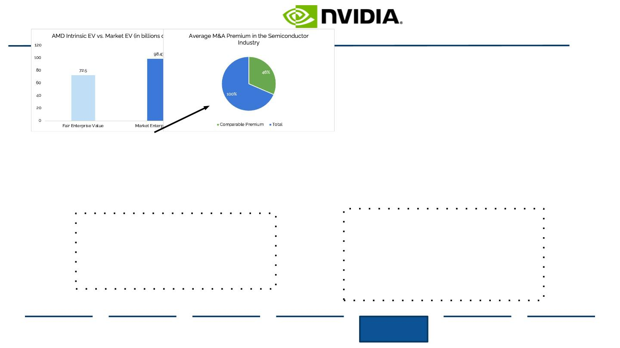
AMD Overvaluation and Purchase Price
Based on Fair EV Calculations, NVDA Should Not Acquire AMD due to Overvaluation and High Premiums
+35.8%
AMD is Highly Overvalued
Based on Intrinsic vs. Market Value
calculations, there is a 35.8% increase from Fair
EV to Market EV. Therefore, Nvidia would be
acquiring a Company that is currently trading at
a $25.9B premium to its intrinsic value.
High Premium to Pay for AMD
The average premium paid in M&A dealings
within the industry and AMD not wanting to sell
is 46%. Therefore, Nvidia would be paying a
premium of $45.18B for AMD—which would
take a massive toll on ﬁnancial ﬂexibility,
especially given its recent spike in debt
obligations.
Source: (Capital IQ, 2020)
Executive
Summary
Industry
Overview
Company
Overview
Financial
Analysis
Acquisition
Feasibility
Alternative
Solution
Conclusion
57

Slide 58
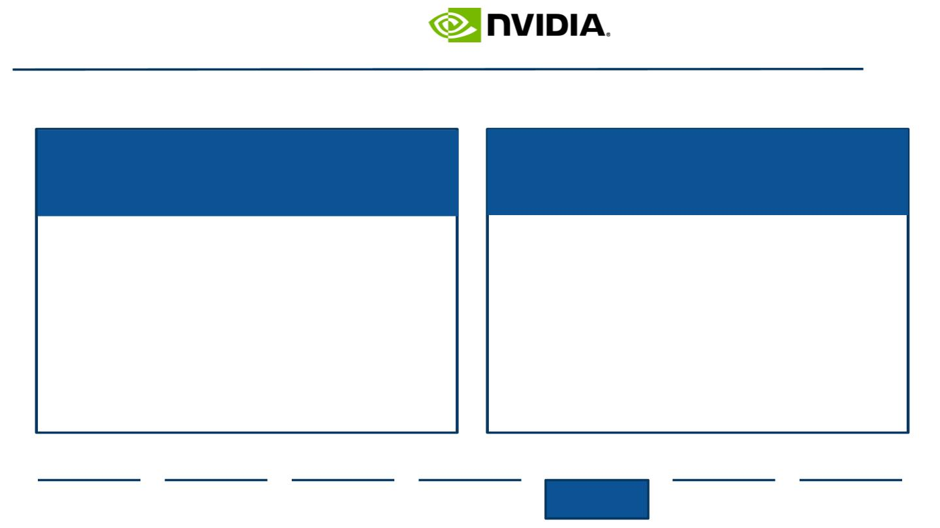
Conclusively...
Nvidia should NOT acquire Advanced Micro Devices.
Synergies do not justify the costs
associated.
Company loses fundamental
innovation driver.
● Financial modeling and DCF show
Advanced Micro Devices is 33.4%
overvalued
● Synergies of $12B do not justify expenses
needed to complete overall transaction
● AMD’s R&D is not highly developed,
compromising Nvidia’s 2021 company goals
●
Debt financing would have to be used to
complete merger and Nvidia overall debt is
considerably high
AMD may institute preventative measures to
protect current patents
Nvidia lessens its ability to deliver quality
products that innovate, along with integration of
partnerships, thereby losing brand value
●
●
Source: (Advanced Micro Devices, 2021), (Nvidia, 2021)
Executive
Summary
Industry
Overview
Company
Overview
Financial
Analysis
Acquisition
Feasibility
Alternative
Solution
Conclusion
58

Slide 59
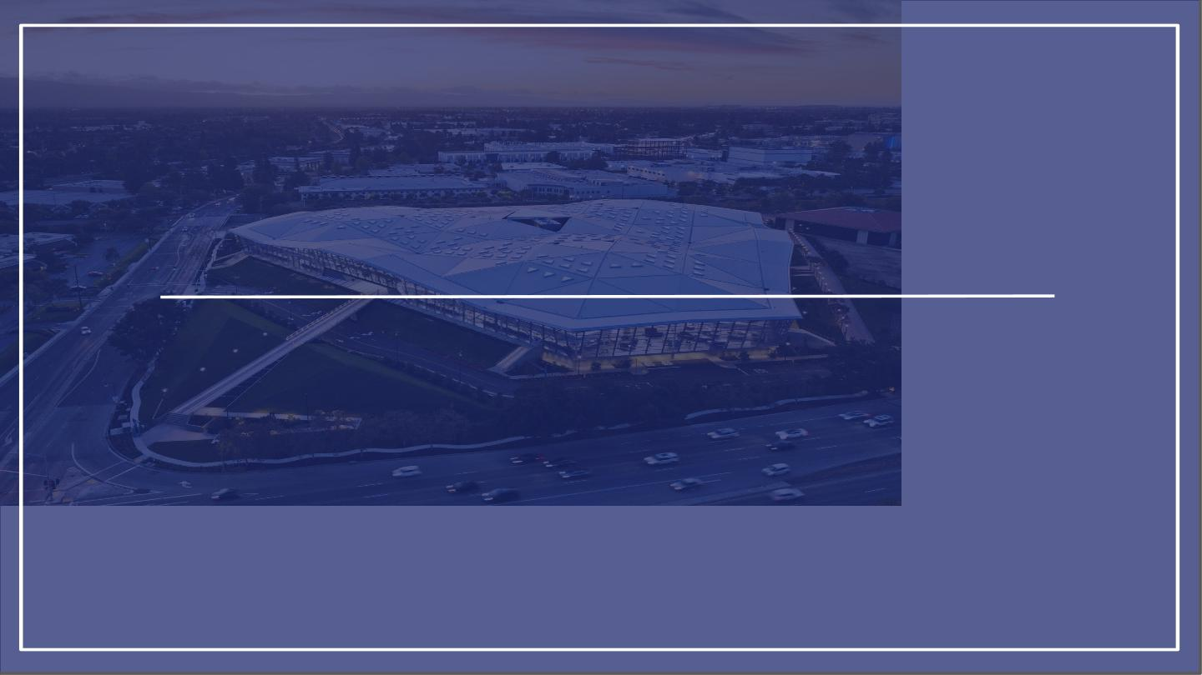
V. Alternative Solution
Looking further
59

Slide 60
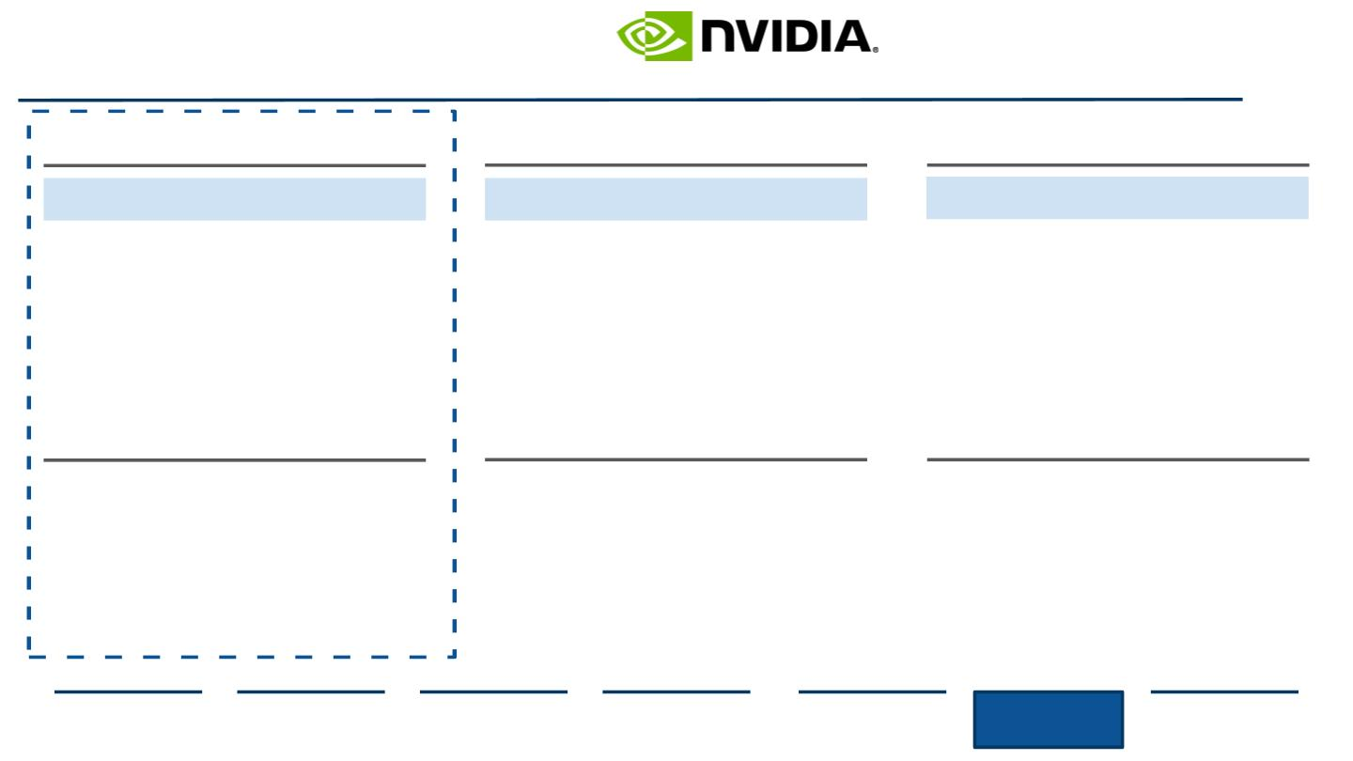
Evaluating Opportunities
Other Options Nvidia Could Pursue Instead of Another Acquisition
Industry Opportunity
Research and Development
Invest in AI Architecture
Supply Chain Visibility
Expand Operations
Add to AI Product Portfolio
● AI market is the fastest
growing in the semiconductor
industry
● AI powered solutions
require big R&D budget
expenditures
● 2020 semiconductor shortage
demonstrated need for
redeﬁnition of operations
● Acquisition will lead to new
revenue segments and
● Sector investment creates
opportunity to develop new
technologies
● Creates opportunity to partially
own or develop a
manufacturing foundry
relevance in industry renewal
Current Eﬀorts in AI
Existing Products and Features
Current Operations Strategy
● Expanding data-centric
● 2020 development of
machine learning chip:
“most powerful chip
system”
● Dependence on partner
foundries to keep up with
chip demand
● However, met 2020 demand
spikes with shortages
● Strong partnership with
TSMC
vision as AI grows
● No announcement of a
consumer-focused AI chip
● Opportunity to expand
● Architecture in place with
no additional assistance
needed
brand portfolio
Source: (Nvidia, 2021), Team Analysis
Executive
Summary
Industry
Overview
Company
Overview
Financial
Analysis
Acquisition
Feasibility
Alternative
Solution
Conclusion
60

Slide 61
Evaluating Opportunities
Other Options Nvidia Could Pursue Instead of Another Acquisition
Acquisition
Partnership
Development
Build AI chips
Buy an AI based company
Utilize partner program for venture
● Acquire existing popular
product lines and utilization
of present AI developments
● May run into integration
complications along with
possible expenses to
● Create partnership using
established program
● However, integrating project
may be time consuming and
expensive considering
long-term timeline
● Gives Nvidia full control of
design process and full
market of distribution
● However, very expensive to
start from ground up and
time consuming to give
leeway to competition
ﬁnance acquisition
Feasibility
Feasibility
Feasibility
● Nvidia’s present trials with ARM
Holdings show company is
looking for investing
● Only allows for limited
control of end
● Good opportunity to
independently own
product/service
● Time constraint for building
consumer wide AI chips
● Increased investment in
initial development of new
technology
opportunities
● Partnership program mainly
utilized for advisory and
internal development, not
new products
● Acquisition will prove beneﬁcial
in long-term strategy of
growing AI investments
Source: (Team Analysis)
Executive
Summary
Industry
Overview
Company
Overview
Financial
Analysis
Acquisition
Feasibility
Alternative
Solution
Conclusion
61

Slide 62

Evaluating Possible Acquisitions
Infeasible
Relevance and Rationale
Product Alignment
Strategic Feasibility
Financial Feasibility
Decision
● Apple is a huge investor in the AI chip
market especially in mobile chip and
SoC innovation
● Dominante the mobile consumer
market and consumer electronics
● Current tensions with
Apple switching to
AMD products
● Apple not looking to
sale and cost too high
● Sheer size of Intel
makes merger
unfeasible
● Currently holds GPU
market share over
Nvidia
● Direct competitor with AMD and
Nvidia in AI and GPU segments
● Many patents and licenses, giving
sole ownership of some AI
innovation/technologies
● Held at a 2.77B
valuation within 4 year
of operation
● High valuation along
with unwillingness to
sell
● Graphcore develops accelerators in
AI and machine learning
● Forecasted disruptor in AI chip
market, already competing even as
a startup
● Internet related services companies
headquartered in Beijing, China
● One of the largest AI developers and
holds partnerships with American
conglomerates like Snap Inc.
● Currently serving
antitrust lawsuits for
past deals
● Chinese company so
US merger is risky
Source: (Apple, 2021), (Crunchbase, 2021), (Graphcore, 2021), (Intel, 2021), (Investopedia, 2021)
Executive
Summary
Industry
Overview
Company
Overview
Financial
Analysis
Acquisition
Feasibility
Alternative
Solution
Conclusion
62

Slide 63

Evaluating Possible Acquisitions
Infeasible
Relevance and Rationale
Product Alignment
Strategic Feasibility
Financial Feasibility
Decision
● Fabless semiconductor software
company specializing in AI data
processing and visualization
● Collaborations in Autonomous
vehicles and data center solutions
● Viable acquisition
● However, doesn’t
align with Nvidia’s end
goal of AI chip
development in
consumer gaming
● Filed for Chapter 11
Protection in 2020
which shows volatility
● May be too much
restructuring and
● VC-backed company with unique
data ﬂow architecture and AI
combination
● Acquires MIPS processors for SoC
for mobile, home,, and IoT devices
integration for Nvidia
● Develops accelerators that have
fastest response and maximum
performance without oﬀset of either
● Newest technology of TSP with ASIC
implementation giving more
●
New startup with
patents in AI hardware
that may disrupt
current industry
● Not looking to sell
computing power
● Media chip specialization in
telecommunications ﬁeld
● AI chip developer in consumer
multimedia products and attractive
“NeuroPilot” technology
● Product alignment with
Nvidia’s media sector
expansion
● Acquiring an
international company
may see challenges
Source: (Groq, 2021), (Kalray, 2021), (MediaTek, 2021), (Wave Technologies, 2021)
Executive
Summary
Industry
Overview
Company
Overview
Financial
Analysis
Acquisition
Feasibility
Alternative
Solution
Conclusion
63

Slide 64

Seeing MediaTek as a Target and Deﬁning What an Acquisition Means for Nvidia
Company Overview
Between 2019-Q4 2020, Mediatek’s revenue climbed 49%
Five units compromise the technology development sector
Based oﬀ Percent of Market Capitalization, March 11,2021
Mediatek: Technology Corporate Functions
YOY %Growth:
2018-2019: 6.3%
2019-2020: 49%
49%
1
SoC System Architecture
Construct and plan technology-leading chips in a single
capacity chip minimizing external hardware
2
Central Design
Implement technologies into chips, including wireless
communication, and artiﬁcial intelligence
3
Wireless Technology
In 2020, MediaTek overtook Qualcomm in Smartphone Chipset Market Share
Global Smartphone Chipset Market Share%, 2019-2020
Develop and design wireless communication core
technologies, system, software, and wireless comms
4
Computing and AI
Research and develop high-eﬃciency computing
platforms and artiﬁcial intelligence technologies
5
Multimedia
Research and develop video and image multimedia
technologies
Source: (MediaTek, 2019), (MediaTek, 2020), (Singh, 2020)
Executive
Summary
Industry
Overview
Company
Overview
Financial
Analysis
Acquisition
Feasibility
Alternative
Solution
Conclusion
64

Slide 65

MediaTek AI Expansion
Plans to Introduce AI Chips for Gaming Smartphones and More
MediaTek’s Helio G95 is newest chip for 4G gaming smartphones
Mediatek Helio G95 Review: MediaTek outperforms chip averages
The race to scale to 5G increases R&D expedentures YoY
MediaTek R&D Spending, 2015-2020, USD Billions
Smaller semiconductor size
is better for space
optimization
Current company commitment to eventually
expand R&D to $6.7B USD to secure growth
opportunities in artiﬁcial intelligence
computing and the ﬁfth generation, or 5G,
wireless communication.
MediaTek’s company partnerships enhance company growth
YoY Sales Growth
Based oﬀ Percent of Market Capitalization, March 11,2021
Based oﬀ Percent of Market Capitalization, March 11,2021
Recent partnerships
have seen the
acceleration of AI.
MediaTek’s close client
relations prove useful
when scaling R&D and
product testing.
Gaming:
Consumer Tech:
Smart Phones:
Sales dropped signiﬁcantly because of regulatory problems in
China. However, Mediatek soon recovered, obtaining new
technology licensure to continue operations.
Artiﬁcial Intelligence:
Source: (MediaTek,2019), (MediaTek, 2021), (Ting-Fang, 2018), (Versus, 2021)
Executive
Summary
Industry
Overview
Company
Overview
Financial
Analysis
Acquisition
Feasibility
Alternative
Solution
Conclusion
65

Slide 66

Past Deals and Beneﬁt of Acquiring MediaTek
MediaTek’s Technology is Well-Regarded and Can be Implemented into NVDA’s Products
MediaTek’s past acquisitions lead to increased market share
How MediaTek plays into Nvidia’s Picture
Mediatek’s Major Acquisitions and Mergers 2006-2016
Evaluating Integration Strategy and the Target
900
909.3 mm
Expanding into the Communications Market
Most of MedTek’s past acquisitions
● Nvidia aims to bring 5G gaming to consumers in gaming
libraries but needs access to a larger
800
700
600
500
400
300
200
100
are undisclosed but operational
alignment shows the next step is
expanding on fabless capabilities
and R&D chip design.
telecommunications company to integrate technology
● MediaTek has a 8.4% 5G chip manufacturing market
share in China, making it one of the largest producers in
the world
● Integration between both companies’ products will
correlate with the race towards broader 5G connectivity
in the AI marketplace
Utilizing Shared Partnerships and AI R&D
Undis.
Undis.
● MediaTek’s NeuroPilot AI ecosystem enhances “Edge AI”
which is gaining traction, especially in the GPU industry
● Integration with Nvidia’s current chips will allow for more
ﬂexibility along with innovative improvements like Cloud
connectivity, decreased run time, and increased
computing power
● MediaTek also improves Nvidia’s Tegra processors,
which account for almost a quarter of revenue, but
MediaTek’s processors are more favored
● Scalability of production and manufacturing integration
also account for a decrease in COGS post merger
Undis.
Undis.
37 mm
2004
Source: (Crunchbase, 2021), (MediaTek, 2021), (Nvidia, 2021)
Executive
Summary
Industry
Overview
Company
Overview
Financial
Analysis
Acquisition
Feasibility
Alternative
Solution
Conclusion
66

Slide 67

Valuation and Cost/Proﬁt of Acquiring MediaTek (Part 1)
Discounted Cash Flow Analysis
MediaTek’s Discounted Cash Flow through 2025
Source: (Capital IQ, 2021)
Executive
Summary
Industry
Overview
Company
Overview
Financial
Analysis
Acquisition
Feasibility
Alternative
Solution
Conclusion
67

Slide 68

Valuation and Cost/Proﬁt of Acquiring MediaTek (Part 2)
WACC Calculation and Capitalization
MediaTek: WACC Calculation
WACC = 5.07%
●
●
●
The Weighted Average Cost of Capital (WACC) represents return to
lenders and shareholders.
MediaTek’s WACC of 5.07% represents the required rate of return
(discount rate) necessary for DCF analysis.
Furthermore, it indicates that the Company must pay investors an
average of $0.0507 for every $1 received in funding.
Source: (Capital IQ, 2021)
Executive
Summary
Industry
Overview
Company
Overview
Financial
Analysis
Acquisition
Feasibility
Alternative
Solution
Conclusion
68

Slide 69

Valuation and Cost/Proﬁt of Acquiring MediaTek (Part 3)
Fair Enterprise Value and Football Field
Enterprise to Equity Value Bridge
Waterfall Chart (in billions of USD)
Football Field
Fair Enterprise Value (in billions of USD)
Enterprise Value (2020A): $43.06B
+ Cash and ST Investments: $7.48B
- Total Debt: $0.76B
Estimated Fair EV Range: $40-46B
Average Fair EV: $43B
Compared to MediaTek’s Market EV of $43.06B, the
Company’s Fair EV of equal amount indicates fair valuation.
Equity Value: $49.77B
Source: (Capital IQ, 2021)
Executive
Summary
Industry
Overview
Company
Overview
Financial
Analysis
Acquisition
Feasibility
Alternative
Solution
Conclusion
69

Slide 70

Medtek Post Acquisition Strategy
Feasible and Target
Rebranding Nvidia’s current GPU lineup with AI Integration...
The Road to Mass Consumer 5G Connectivity...
5G Gaming
Expand Nvidia’s product portfolio in Mobile APU gaming
segments. Integration of MediaTek’s SDK allows
developers to ‘write once, apply everywhere’ for existing
and future devices. Methodology can integrate with
Nvidia’s applications.
Multimedia Partnerships
● Integrate MediaTek NeuroPilot technology into chip
Capitalize on shared partnerships between companies
and existing SDKs like Google TensorFlow, Caﬀe, Amazon
MXNet, Sony NNabla and more. At the OS level, MediaTek
oﬀers support for Android and Linux.
● Nvidia’s current design allows for ﬂexibility of new
innovation additions, especially programmable
integration
● Utilize combined partner TSCM manufacturing to
increase production process and meet unexpected
demands heightened by the semiconductor shortage
Streaming VR and AR
● Post launch: expansion into the telecommunications
industry after trial sales rounds to assess consumer
reactions to acquisition
NVIDIA CloudXR™ SDK enables the streaming of OpenVR
applications to 5G-connected Android and Windows
devices. Enable Edge streaming with Mediatek’s
NeuroPilot platform.
Source: (Nvidia, 2021), (MediaTek, 2021)
Executive
Summary
Industry
Overview
Company
Overview
Financial
Analysis
Acquisition
Feasibility
Alternative
Solution
Conclusion
70

Slide 71

VI. Conclusion
Final De...cisions
71

Slide 72

Therefore...
Nvidia Should Not Acquire Advanced Micro Devices and Should Instead Opt for a More
Synergistic and Cost-Eﬀective Approach: Acquiring MediaTek
Should Nvidia acquire Advanced Micro Devices (AMD)?
Valuation
and Cost
Synergies
Alternative
AMD’s lack of R&D alignment with
prospective new innovation in AI,
along with potential complications
that come with organizational
restructuring, make an acquisition
unviable.
Although there is an estimated
synergies amount of $12B, the
potential beneﬁts would be severely
outweighed by the ﬁnancial losses
incurred due to AMD’s overvaluation.
Nvidia should acquire MediaTek due
to the new target’s fair valuation,
combined with product alignment and
on-trend AI technology.
Executive
Summary
Industry
Overview
Company
Overview
Financial
Analysis
Acquisition
Feasibility
Alternative
Solution
Conclusion 72

Slide 73
Appendix
A Deeper Dive
73

Slide 74

Industry Analysis
Illustrating the Nature of the Semiconductor Industry
Year Over Year Revenue Growth of the Semiconductor Industry
1988-2021
Cyclic nature of the semiconductor
industry is shown but general trend
is down as Moore’s Law is coming to
a halt.
Source: (Statista, 2020)
Appendix
Industry Overview
74

Slide 75

Industry Analysis
Semiconductor Capital Expenditure
Capital expenditure in the global semiconductor industry
2000-2021
Investments to increase computing
power are on the rise, especially in
the AI and machine learning ﬁelds
Source: (Statista, 2021)
Appendix
Industry Overview
75

Slide 76

Industry Analysis
Global Key Players and Charting China’s Growth
Semiconductor sales by region, USD Billions
2015-2019
China had dramatically increased
manufacturing, imports, and exports
of semiconductors in an attempt to
become self suﬃcient. Currently, the
country only manufactures 30% of
semiconductors used.
Source: (Nvidia, 2021), (MediaTek, 2021)
Appendix
Industry Overview
76

Slide 77

Industry Analysis
US Dependence on China
Domestic M&A Volume Growth- East Asia
2014-2018
US deﬁcits with China, USD Billions
As of 2018
18%
30%
2018
89
2016
51
2017
11
11
10
11
6
10
10
2
73
2
China
South Korea
Japan
Taiwan
Source: (Deloitte, 2020)
Appendix
Industry Overview
77

Slide 78

Industry Analysis
Nvidia’s Dependence on Chinese Markets
Nvidia Semiconductor Revenue by Region
Nvidia Regional Revenue Breakdown
2017-2020
2020
Nvidia Geographical Segment Revenues, USD Mn
Taiwan
US
13.3%
China
37.6%
China
US
Taiwan
38.3%
Europe
Europe
10.7%
Source: (Nvidia, 2021)
Appendix
Industry Overview
78

Slide 79

Financial Analysis: Comparables- Supplemental AMD Peer Group Information
3-Year NTM P/E Multiple Valuation Graphs for Comparable Companies
Source: (Capital IQ, 2021)
Appendix
Financial Analysis
79

Slide 80

Financial Analysis: Comparables- Precedent Transaction Analysis
Comparing Company Financials
Evaluating a Transaction
Source: (Capital IQ, 2021)
Appendix
Financial Analysis
80

Slide 81

Financial Analysis: Supplemental AMD Financial Data
Multiples Sensitivity Analysis
NTM P/E Multiple Calculation
Implied Share Price and Implied Return Sensitivity
Source: (Capital IQ, 2021)
Appendix
Financial Analysis
81

Slide 82

Financial Analysis: Supplemental AMD Financial Data
Multiples Sensitivity Analysis
NTM EV/EBITDA Multiple Calculation
Implied Share Price and Implied Return Sensitivity
Appendix
Source: (Capital IQ, 2021)
82
Financial Analysis

Slide 83

Acquisition Feasibility- Evaluating Possible Acquisitions- A Deeper Analysis
Infeasible Acquisitions
Relevance and Rationale
Decision
● Fabless semiconductor software company specializing in AI data processing and visualization
● Sheer size of Apple shows the company is not willing
● Collaborations in Autonomous vehicles and data center solutions although main market in consumer
to sell and company would overtake Nvidia
electronics. Several collaborations and investment expenditures in the AI industry, speciﬁcally mobile. ● From a value perspective, Apple does not have a big
● Large Deep Learning, Reinforcement Learning, and Research funds aimed at unsupervised learning
● Developing/expanding on natural language processing and speech technologies with Siri platform
share in gaming markets and therefore cannot match
Nvidia’s main goal of integrating AI in gaming GPUs
● One of the biggest semiconductor companies in the world centered on AI innovation
● Currently the sole proprietor of over 90,000 patents and expanding especially in AI Edge integration
● Global partner ecosystem encourages company innovation and allowance of new architecture
development to build new products and form new partnerships
● Flexibility of chip is especially attractive with multi-purposeness, cloud connectivity, and
customization. Expanding all services on SoCs are becoming more of a revenue driver as AI increases
● Intel’s dominant market share indicates they would no
be willing to sell even one of their business segments
Currently hold leading GPU market share.
● AI segments are not as largely focused on gaming as
Nvidia so business priorities regarding R&D
misaligned
● Owned by serial chip entrepreneurs who sold last company Icera to Nvidia for $435 million in 2011
● High valuation along with unwillingness to sell
● Starting to become a huge threat to major industry players with SoC designs and new IPU systems
makes acquisition unfeasible
● Forecasted to be transformative across all industries and had received $222M USD in Serial E funding ● Graphcore mainly operates in home, automobile,
● Current valuation holds at $2.77B USD and has many strategic backers like Microsoft, BMW, and Dell
● One of the major threats to Nvidia as customers ﬂock to the innovation and start-up culture
and mobile services, not gaming which is Nvidia’s
main operational focus.
● Chinese multinational technology company specializing in Internet-related services and products and
artiﬁcial intelligence.
● Currently serving antitrust lawsuits for past mergers
and acquisitions deals
● Risk analysis proves more harm than good when
partnering with Baidu even though AI tradeoﬀ is
beneﬁcial
● Second largest search engine in the world, occupying 76.5% of China’s search engine market share
● Entered the GBU market as a major player with partnership with Snap Inc as company's oﬃcial ad
reseller
Source: (Apple, 2021), (Crunchbase, 2021), (Graphcore, 2021), (Intel, 2021), (Investopedia, 2021)
Appendix
Acquisition Feasibility
83

Slide 84

Acquisition Feasibility- Evaluating Possible Acquisitions- A Deeper Analysis
Feasible and Target Acquisitions
Relevance and Rationale
Decision
● Fabless semiconductor software company specializing in AI data processing and visualization
● Viable acquisition, however, doesn’t align with Nvidia’s
● Collaborations in Autonomous vehicles and data center solutions
end goal of AI chip development in consumer gaming
● Kalray’s acquisition of MPAA (Massively Parallel Processor Array) is patented and serves as a unique ● ,Kalray mainly focuses on machine learning in data
positioning platform for the companies diﬀerentiating in data center innovation and machine learning centers which Nvidia already has stakes in including a
● Oﬀers programmable and ﬂexible NVMe-oF Smart Storage Adaptor along with SDK environments
well developed partner program.
● VC-backed company with unique data ﬂow architecture and AI combination
● Acquired MIPS processors for SoC for mobile, home,, and IoT devices and integrates for professional
partnerships with companies like Microsoft, Dell, Cisco, Maraki, and Barracuda
● Developing AI native dataﬂow technology which is a dataﬂow application that demands a dataﬂow
processor, eliminating host and co-processor in the calculations of a neural network
● Filed for Chapter 11 Protection (bankruptcy) in 2020
which shows volatility
● May be too much restructuring and integration for
Nvidia especially ﬁnancing a company in debt
● SoC technology attractive but doesn’t outweigh
negatives
● Develops accelerators that have fastest response and maximum performance without oﬀset
● Newest technology of TSP with ASIC implementation giving more computing power
● New startup with patents in AI hardware that may
disrupt current industry
● Development of AI integration with robotics for example pipe bots which keep sewer pipes clean
● Hardware capable of performing over 400,000 multiplications before one byte is retrieved from
memory on a GPU. GPU integration with Nvidia may open up new projects and markets to explore
● Not looking to sell but Tensor processors and Tegra
units align with half of Nvidia’s business segments
● Media chip specialization in telecommunications ﬁeld
● Product expansion with Nvidia’s media sector and 5G
gaming connectivity with gaming processors
● Acquiring an international company may see
challenges but business strategy and segments can
● AI chip developer in consumer multimedia products and attractive “NeuroPilot” technology
● Helps achieve Nvidia’s like mindedness of a “data centric” and “data driven” organization by
implementing AI architecture in product spheres and increase 5G networks globally
● Also has a gaming sector and chip deﬁcits have presented with GPU shortages aka Nvidia’s speciality easily align and integrate with one another,
Source: (Groq, 2021), (Kalray, 2021), (MediaTek, 2021), (Wave Technologies, 2021)
Appendix
Acquisition Feasibility

Slide 85

Alternative Solution- Company Targets: Comparing Margin Projections
Proﬁt, EBIT, and EBITDA Margins for AMD and MediaTek
While EBITDA and EBIT Margin growth
EBIT, EBITDA, and Proﬁt Margins see
is relatively ﬂat through the projection
period, Proﬁt Margins see a spike from
2019A-2020A, and return to normal
levels through 2025.
slight growth from 2020A-2021E, and a
fairly ﬂat growth in margins for the
remaining years through 2025.
Source: (Advanced Micro Devices, 2021), (Capital IQ, 2021)
Appendix
Feasibility
85

Slide 86

Alternative Solution- Supplemental MediaTek Financial Data
Revenue Projections for Sole Business Segment
Total Revenue Projections through 2025
MediaTek Segment Breakdown
The Company has one reportable business segment
Source: (MediaTek, 2021)
Appendix
Alternative Solution
86

Slide 87

Alternative Solution- Supplemental MediaTek Financial Data
Multiples Sensitivity Analysis
NTM P/E Multiple Calculation
Implied Share Price and Implied Return Sensitivity
Source: (Capital IQ, 2021)
Appendix
Alternative Solution
87

Slide 88

Alternative Solution- Supplemental MediaTek Financial Data
Multiples Sensitivity Analysis
NTM EV/EBITDA Multiple Calculation
Implied Share Price and Implied Return Sensitivity
Source: (Capital IQ, 2021)
Appendix
Alternative Solution
88

Slide 89

Alternative Solution- Supplemental MediaTek Financial Data
DCF Sensitivity Analysis- Exit Multiple Method
Exit Multiple Method
Calculation of Implied EBITDA Multiple
Exit Multiple Method is used to
calculate the terminal value of the
Company’s FCFs, under the
assumption that business value
will be determined at the end of
the projection period.
Source: (Capital IQ, 2021)
Appendix
Alternative Solution
89

Slide 90

Alternative Solution- Supplemental MediaTek Financial Data
DCF Sensitivity Analysis- Perpetual Growth Rate
Perpetual Growth Rate (PGR) Method
Calculation of Implied Terminal Growth Rate
Perpetual Growth Rate
Method assumes a
constant rate of cash ﬂow
generation into perpetuity.
Source: (Capital IQ, 2021)
Appendix
Alternative Solution
90

Slide 91
Bibliography
91

Slide 92

Bibliography
Accenture, 2019. Semiconductor Industry Leads in Artificial Intelligence Adoption, Accenture Report Finds. [Online] Available at:
https://newsroom.accenture.com/industries/electronics-high-tech/semiconductor-industry-leads-in-artificial-intelligence-adoption-accenture-report-finds.htm
[Accessed 9 March 2021].
Advanced Micro Devices, 2016. AMD Publishes 21st Annual Corporate Responsibility Report. [Online] Available at:
https://www.amd.com/en/press-releases/amd-publishes-21st-2016jun14 [Accessed 11 March 2021].
Advanced Micro Devices, 2021. 10-K, Santa Clara: Advanced Micro Devices.
Advanced Micro Devices, 2021. AMD Reports Fourth Quarter and Full Year 2020 Financial Results , Santa Clara: AMD.
Advanced Micro Devices, 2021. Quality Management. [Online] Available at:
https://www.amd.com/en/corporate/quality#:~:text=Quality%20Management&text=Highly%20differentiated%20customer%20collaboration%20and,towards%
20consistent%20standards%20and%20processes [Accessed 10 March 2021].
Alam, S., 2020. Accenture. [Online] Available at: https://www.accenture.com/us-en/insights/strategy/semiconductor-mergers-acquisitions [Accessed 9 March
2021].
Apple, 2021. Apple Newsroom. [Online] Available at: https://www.apple.com/newsroom/ [Accessed 11 March 2021].
Ashkenas, R., 2019. Surviving M&A. [Online] Available at: https://hbr.org/2017/03/surviving-ma [Accessed 8 March 2021].
Athow, D., 2020. Watch out Intel and Nvidia, AMD just made a game-changing acquisition. [Online] Available at:
https://www.techradar.com/news/watch-out-intel-and-nvidia-amd-just-made-a-game-changing-acquisition [Accessed 8 March 2021].
Baidu, 2021. Annual revenue of Baidu from 2008 to 2019. [Online] Available at: https://www.statista.com/statistics/269032/annual-revenue-of-baidu/ [Accessed
7 March 2021].
Bibliography
92

Slide 93

Bibliography
Capital IQ, 2021. MediaTek: Public company profile, s.l.: Capital IQ.
Capital IQ, 2021. Nvidia: Public company profile, s.l.: Capital IQ.
CNN, 2021. Advanced Micro Devices Inc. [Online] Available at:
https://money.cnn.com/quote/shareholders/shareholders.html?symb=AMD&subView=institutional [Accessed 10 March 2021].
CNN, 2021. NVIDIA Corp (NASDAQ:NVDA). [Online] Available at: https://money.cnn.com/quote/competitors/competitors.html?symb=NVDA [Accessed 11
March 2021].
Companies Market Cap, 2021. Largest semiconductor companies by market cap. [Online] Available at:
https://companiesmarketcap.com/semiconductors/largest-semiconductor-companies-by-market-cap/ [Accessed 10 March 2021].
Craft Co., 2021. AMD headquarters and office locations. [Online] Available at: https://craft.co/amd/locations [Accessed 7 March 2021].
Crunchbase, 2021. Graphcore. [Online] Available at: https://www.crunchbase.com/organization/graphcore [Accessed 12 March 2021].
Crunchbase, 2021. List of NVIDIA's 18 Acquisitions, including Arm Holdings and Cumulus Networks. [Online] Available at:
https://www.crunchbase.com/search/acquisitions/field/organizations/num_acquisitions/nvidia [Accessed 11 March 2021].
CSI Market, 2020. Advanced Micro Devices Inc 's Suppliers Performance , s.l.: CSI Markets. Deloitte, 2019. Semiconductors – the Next Wave , Beijing:
Deloitte.
Deloitte, 2020. Technology, Media, and Telecommunications Predictions 2020. [Online] Available at:
https://www2.deloitte.com/content/dam/insights/us/articles/722835_tmt-predictions-2020/DI_TMT-Prediction-2020.pdf [Accessed 7 March 2021].
Bibliography
93

Slide 94

Bibliography
Dent, S., 2018. Major AMD chip supplier will no longer make next-gen chips. [Online] Available at:
https://www.engadget.com/2018-08-28-global-foundries-stops-7-nanometer-chip-production.html [Accessed 10 March 2021].
Deutsche Bank, 2021. Strong qtr/guide, but crypto/shortage dynamics raise uncertainty, s.l.: Thomson One.
Evercore ISI, 2021. Climbing A Wall of Worry – Jensen Style, s.l.: Thomson One.
Fintel, 2021. Institutional Ownership and Shareholders. [Online] Available at: https://fintel.io/so/us/nvda [Accessed 12 March 2021].
Fortune Business Insights, 2018. Fortune Business Insights. [Online] Available at: https://www.fortunebusinessinsights.com/semiconductor-market-102365
[Accessed 10 March 2021].
Graphcore, 2021. Our Purpose. [Online] Available at: https://www.graphcore.ai/about [Accessed 12 March 2021].
Groq, 2021. Introducing the Tensor Streaming Process. [Online] Available at: https://groq.com/technology/ [Accessed 9 March 2021].
Harvard Business Review, 2016. A 5-Step Process for Reorganizing After a Merger. [Online] Available at:
https://hbr.org/2016/12/a-5-step-process-for-reorganizing-after-a-merger [Accessed 8 March 2021].
Hruska, J., 2021. Chip Demand Outstrips Supply by 30 Percent, Shortages Could Last a Year. [Online] Available at:
https://www.extremetech.com/computing/320247-chip-demand-outstrips-supply-by-30-percent-shortages-could-last-a-year [Accessed 11 March 2021].
Infront Analytics, 2021. Nvidia Corp.. [Online] Available at: https://www.infrontanalytics.com/fe-EN/31436NU/NVIDIA-Corp-/market-valuation [Accessed 9
March 2021].
Intel, 2021. Our Purpose. [Online] Available at: https://www.intel.com/content/www/us/en/company-overview/company-overview.html [Accessed 8 March
2021].
Bibliography
94

Slide 95
Bibliography
Investopedia, 2019. What Are "Fabless" Chip Makers?. [Online] Available at:
https://www.investopedia.com/ask/answers/050615/what-are-fabless-chip-makers-and-why-are-they-important-semiconductor-market.asp [Accessed 10 March
2021].
Investopedia, 2021. What Is Baidu?. [Online] Available at:
https://www.investopedia.com/terms/b/baidu.asp#:~:text=Baidu%2C%20Inc.%20was%20incorporated%20on,and%20artificial%20intelligence%20(AI).&text=
It%20is%20one%20of%20the,internet%20companies%20in%20the%20world. [Accessed 11 March 2021].
J.P. Morgan, 2021. Advanced Micro Devices, s.l.: Thomson One.
Jon Peddie Research, 2021. PC discrete graphics processing unit (dGPU) shipment share worldwide from 1st quarter 2019 to 4th quarter 2020, by vendor.
[Online]
Available at: jonpeddie.com[Accessed 8 March 2021].
Kalray, 2021. Kalray’s Unique MPPA® Manycore Technology. [Online] Available at: https://www.kalrayinc.com/ [Accessed 10 March 2021].
Khaveen Investments, 2021. AMD: Full Throttle Expansion Across All Market Segments. [Online] Available at:
https://seekingalpha.com/article/4406336-amd-full-throttle-expansion-across-all-markets-segments [Accessed 7 March 2021].
Ma, K.-C., 2019. [Online] Available at: https://seekingalpha.com/article/4234347-nvidia-watch-out-for-china [Accessed 7 March 2021].
McKinsey & Company, 2019. Artificial-intelligence hardware: New opportunities for semiconductor companies. [Online] Available at:
https://www.mckinsey.com/industries/semiconductors/our-insights/artificial-intelligence-hardware-new-opportunities-for-semiconductor-companies [Accessed
10 March 2021].
Bibliography
95

Slide 96
Bibliography
MediaTek, 2016. MediaTek Annual Report 2016, Taipei: MediaTek.
MediaTek, 2017. MediaTek Annual Report 2017, Taipei: MediaTek.
MediaTek, 2018. MediaTek Annual Report 2018, Taipei: MediaTek.
MediaTek, 2019. MediaTek Annual Report 2018, Taipei: MediaTek.
MediaTek, 2020. MediaTek Annual Report 2020, Taipei: MediaTel.
MediaTek, 2021. Core Businesses. [Online] Available at: https://i.mediatek.com/about-mediatek [Accessed 7 March 2021].
Morgan Stanley, 2021. Gaming above high expectations, with data center businesses in line, s.l.: Thomson One.
Morgan, T., 2020. AMD is Determined to Get its Rightful Datacenter Share. [Online] Available at:
https://www.nextplatform.com/2020/03/06/amd-is-determined-to-gets-its-rightful-datacenter-share/ [Accessed 12 March 2021].
Nvidia, 2019. 2019 Nvidia Corporate Social Responsibility Report, Santa Clara: Nvidia.
Nvidia, 2021. 10-K, Santa Clara: Nvidia.
Nvidia, 2021. Contact Nvidia. [Online] Available at: https://www.nvidia.com/en-us/contact/ [Accessed 10 March 2021].
Nvidia, 2021. Form 10-K, Santa Clara: Nvidia.
Nvidia, 2021. Nvidia Partner Network. [Online] Available at: https://www.nvidia.com/en-us/about-nvidia/partners/ [Accessed 7 March 2021].
Bibliography
96

Slide 97
Bibliography
Nvidia, n.d. NVIDIA Enterprise-Class Networking. [Online] Available at: https://www.nvidia.com/en-us/drivers/feature-network/ [Accessed 9 March 2021].
Oh, N., 2018. Cryptomining Demand Drives Especially High Graphics Cards Shipments in 2017. [Online] Available at:
https://www.anandtech.com/show/11762/cryptomining-demand-drives-exceptionally-high-graphics-card-shipments-in-q2-2017 [Accessed 8 March 2021].
PassMark, 2020. Distribution of Intel and AMD x86 laptop central processing units (CPUs) worldwide from 2012 to 2020, by quarter. [Online] Available at:
https://www.cpubenchmark.net/market_share.html [Accessed 10 March 2021].
Pirzada, U., 2019. AMD Overtakes NVIDIA In GPU Market Share For The First Time Since Q3 2014 – Jon Peddie Research. [Online] Available at:
https://wccftech.com/amd-overtakes-nvidia-marketshare-q2-2019/ [Accessed 8 March 2021].
PricewaterhouseCoopers , 2016. China’s impact on the semiconductor industry: 2016 update, s.l.: PricewaterhouseCoopers .
Primate Labs, 2021. Ranking of leading single-core processors by Geekbench score performance worldwide as January 2021. [Online] Available at:
https://browser.geekbench.com/processor-benchmarks [Accessed 8 March 2021].
Ray, T., 2021. AMD sees another six months of video game chip shortages. [Online]
Available at: https://www.zdnet.com/article/amd-sees-another-six-months-of-video-game-chip-shortages/ [Accessed 8 March 2021].
Reif, N., 2020. 5 Companies Owned by Nvidia. [Online] Available at: https://www.investopedia.com/5-companies-owned-by-nvda-5092734 [Accessed 8 March
2021].
Reuters, 2020. Nvidia lays out plan to create new kind of data center chip. [Online]
Available at: https://www.reuters.com/article/us-nvidia-tech/nvidia-lays-out-plan-to-create-new-kind-of-data-center-chip-idUSKBN26Q20X [Accessed 7 March
2021].
Bibliography
97

Slide 98
Bibliography
Rotman, D., 2020. We’re not prepared for the end of Moore’s Law. [Online] Available at:
https://www.technologyreview.com/2020/02/24/905789/were-not-prepared-for-the-end-of-moores-law/ [Accessed 14 March 2020].
Semi Conductor Industry Association, 2019. Statista. [Online] Available at:
https://www.statista.com/statistics/249509/forecast-of-semiconductor-revenue-in-the-americas-since-2006/ [Accessed 10 March 2021].
Semiconductor Industry Association, 2019. SIA 2019 Factbook, s.l.: Semiconductor Industry Association.
Singh, K., 2020. MediaTek-powered phones outsold Qualcomm for the first time in Q3 2020. [Online] Available at:
https://www.androidpolice.com/2020/12/28/mediatek-powered-phones-outsold-qualcomm-for-the-first-time-in-q3-2020/ [Accessed 8 March 2021].
Statista, 2018. Nvidia Graphics Cards Still Top Choice For PC Gamers. [Online] Available at:
https://www.statista.com/chart/15172/the-pc-graphics-card-market-share-among-gamers-on-steam/ [Accessed 8 March 2021].
Statista, 2019. statista. [Online] Available at: https://www.statista.com/chart/18211/companies-with-the-most-ai-patents/ [Accessed 11 March 2021].
Statista, 2020. Semiconductor unit shipments worldwide from 2000 to 2020. [Online] Available at:
https://www.statista.com/statistics/802632/world-semiconductor-shipments/ [Accessed 12 March 2021].
Statista, 2020. Semiconductor unit shipments worldwide from 2000 to 2020. [Online] Available at:
https://www.statista.com/statistics/802632/world-semiconductor-shipments/ [Accessed 8 March 2021].
Statista, 2021. https://www.statista.com/topics/1182/semiconductors/. [Online] Available at: https://www.statista.com/topics/1182/semiconductors/ [Accessed 6
March 2021].
Statista, 2021. Microprocessor and graphics processing unit (GPU) market size worldwide in 2020 and 2025. [Online] Available at:
https://www.statista.com/statistics/1176972/microprocessor-gpu-market-size-worldwide/ [Accessed 11 March 2021].
Bibliography
98

Slide 99
Bibliography
Statista, 2021. Nvidia research and development expenses worldwide from 2017 to 2021. [Online] Available at:
https://www.statista.com/statistics/988048/nvidia-research-and-development-expenses/ [Accessed 11 March 2021].
Statista, 2021. Nvidia revenue worldwide from 2015 to 2021, by segment. [Online] Available at:
https://www.statista.com/statistics/988034/nvidia-revenue-by-segment/#:~:text=Nvidia%20revenue%20worldwide%202015%2D2021%2C%20by%20segment
&text=In%20their%202021%20fiscal%20year,to%206.84%20billion%20U.S.%20dollars. [Accessed 10 March 2021].
Tech Power Up, 2020. TSMC Partners With Google and AMD to Push 3D Silicon. [Online] Available at:
https://www.techpowerup.com/275209/tsmc-partners-with-google-and-amd-to-push-3d-silicon [Accessed 11 March 2021].
Ting-Fang, C., 2018. MediaTek boosts R&D spend by up to $3.3bn to secure growth. [Online] Available at:
https://asia.nikkei.com/Business/Companies/MediaTek-boosts-R-D-spend-by-up-to-3.3bn-to-secure-growth [Accessed 8 March 2021].
Trefis, 2021. How Does AMD Spend Its Money? , s.l.: Forbes.
Versus, 2021. Mediatek Helio G95 review: specs and price. [Online] Available at: https://versus.com/en/mediatek-helio-g95 [Accessed 10 March 2020].
Walton, J., 2021. GPU Benchmarks and Hierarchy 2021: Graphics Cards Ranked. [Online] Available at:
https://www.tomshardware.com/reviews/gpu-hierarchy,4388.html [Accessed 12 March 2021].
Walton, S., 2020. Cyberpunk 2077 Benchmarked. [Online] Available at: https://www.techspot.com/article/2164-cyberpunk-benchmarks/ [Accessed 8 March
2021].
Wave Technologies, 2021. Wave Technologies are your partners in productivity. [Online] Available at: https://www.waveiton.com/ [Accessed 7 March 2021].
Bibliography
99

Slide 100
Bibliography
Witkowski, W., 2021. AMD expects gaming, data center to remain strong in 2021 as quarterly revenue tops $3 billion for first time. [Online] Available at:
https://www.marketwatch.com/story/amd-quarterly-revenue-tops-3-billion-for-first-time-and-forecasts-strong-2021-11611696093#:~:text=The%20company%2
0expects%20first%2Dquarter,or%20to%20about%20%2413.37%20billion. [Accessed 7 March 2021].
World Semiconductor Trade Statistics, 2020. WSTS Semiconductor Market Forecast Fall 2020, San Jose: World Semiconductor Trade Statistics.
WSTS, 2020. Global semiconductor industry revenue growth from 1988 to 2021. [Online] Available at:
https://www.wsts.org/esraCMS/extension/media/f/WST/4820/WSTS_nr-2020_11.pdf [Accessed 7 March 2021].
Zafar, R., 2020. AMD Hopes To Earn $22 Billion Revenue In 2025 For A Staggering 232% Growth Over 2019!. [Online] Available at:
https://wccftech.com/amd-22-billion-2025-growth-2019/ [Accessed 10 March 2021].
Bibliography
100

